Slide 1


INSTITUTE FOR ADVANCED COMPUTING AND SOFTWARE DEVELOPMENT AKURDI, PUNE
Power Point Presentation on
“Book My Doc System”
PG-DAC MARCH 2023
Submitted By:
Group No: 87
Name : PRN:
Mohan Talavar (233169) 230341220099
Pranay Patil (233185) 230341220130

Slide 2
Introduction
This document outlines the business requirements and scope of the Doctor's Appointment System. Its purpose is to define functional and non-functional requirements, business rules, and constraints.
In the context of the pandemic, the project underscores the significance of internet power and the need to address issues in manually managing medical records. The project aims to eliminate errors and long waiting times, leading to savings in effort, funds, and work.
The system's objective is to develop a website that reduces patient waiting times and hospital crowding. It primarily focuses on managing Doctor and patient details, test information, and booking numbers. The system ensures secure and organized storage of records for future reference.

Slide 3
Objective
The objective of the Online Doctor Appointment Booking Web Application is to provide users a convenient, efficient, and user-friendly solution for scheduling medical appointments. Our platform presents a comprehensive list of doctors, including their schedules and availability in specific hospitals. This empowers users to make well-informed decisions and seamlessly book appointments, eliminating the need for unnecessary visits. By minimizing such visits, our system enhances hospital efficiency, reduces wait times, and ensures a smoother experience for both doctors and patients.

Slide 4
Scope
This System is designed to offer a user-friendly solution for scheduling medical appointments and services exclusively within a single, chosen hospital. The application will empower users with the ability to access doctor information, schedules, and availability within the confines of this hospital, ensuring a seamless and informed booking experience. While presently focused on a specific hospital, the project's potential expansion to encompass multiple healthcare facilities remains a possibility for future iterations.

Slide 5
Technology Used
Frontend:
React: Used for building the user interface, ensuring a responsive and intuitive user experience.
Backend:
Java Spring Boot: Employed to create the business logic layer, providing robust and efficient backend services.
Database:
MySQL: Chosen as the backend database management system for secure storage and retrieval of data.
This technology stack ensures a seamless and user-friendly Doctor's Appointment System, leveraging the strengths of each component for a comprehensive solution.

Slide 6
Software & Hardware Configuration
For front-end-server:
Windows10 & higher version
Web browser: Chrome , Microsoft Edge
Intel i5 10th gen or higher
Minimum 4 gb Ram
Minimum 64 gb Hard Disk Drive
Monitor , Keyboard , Mouse
64-Bit Operating System
For Back-end-server:
Windows10 & higher version
MySQL 8.0
Apache Tomcat Server
Monitor , Keyboard , Mouse
64-Bit Operating System
Intel i5 10th gen or higher
Minimum 8 gb Ram
Minimum 128 gb Hard Disk Drive

Slide 7
Functionality
The Doctor’s Appointment System is composed of three distinct modules, each designed to serve a specific role within the application:
Admin Module:
Admin can log in to the system.
Admin can register a newly recruited doctor.
Admin can view a comprehensive list of all registered doctors and patients.
Admin possesses the authority to view detailed information about doctors and patients, as well as the capability to remove them.
Admin can access and review the complete schedule of appointment bookings for all doctors.
Admin is empowered to approve or reject patient appointment cancellation requests.

Slide 8
Doctor Module:
Doctors can log in to their accounts.
Doctors can add or modify their availability schedules.
Doctors can access details of revisiting patients to enhance personalized care.
Doctors can view their own appointment schedules.
Patient Module:
Patients can register within the system and subsequently book appointments.
Registered patients can securely log in to their accounts.
Patients can initiate the booking and cancellation of appointments.
Patients can access their prescribed treatment plans provided by the doctors.
Patients can request password reset in case of forgotten credentials.

Slide 9
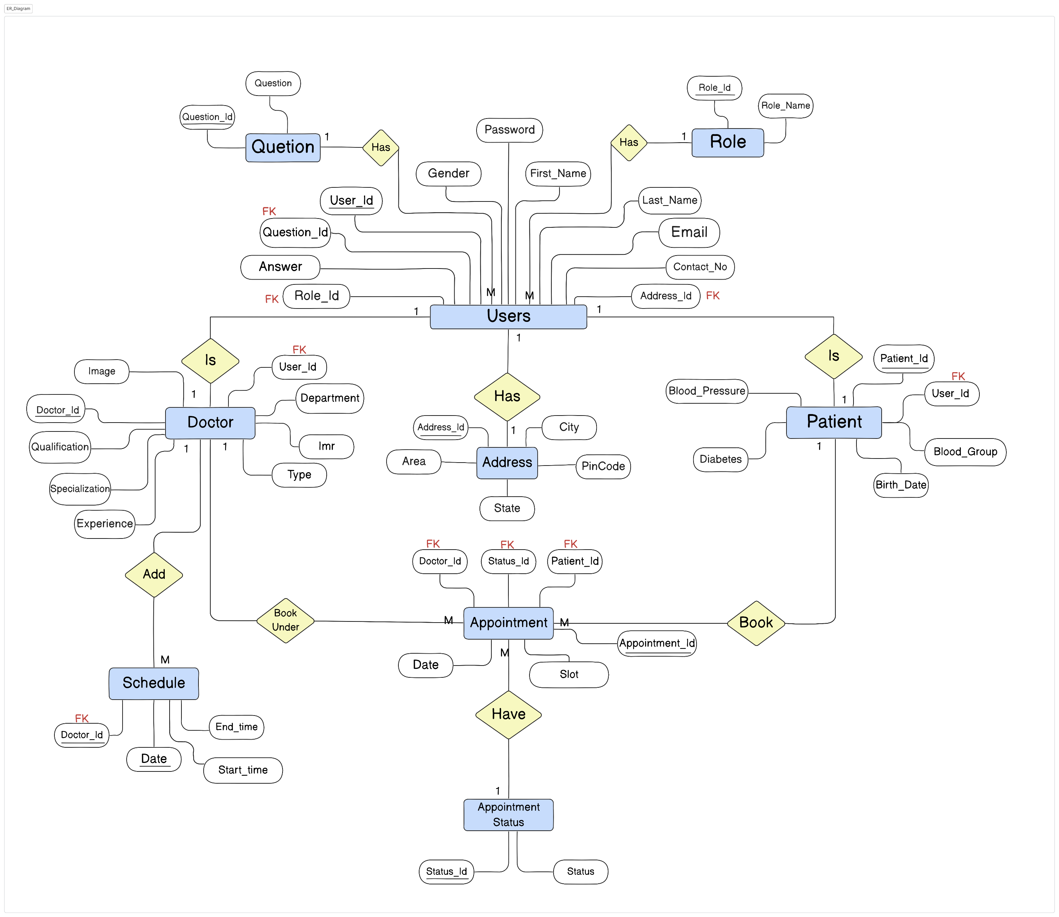
Entity-Relationship Diagrams

Slide 10
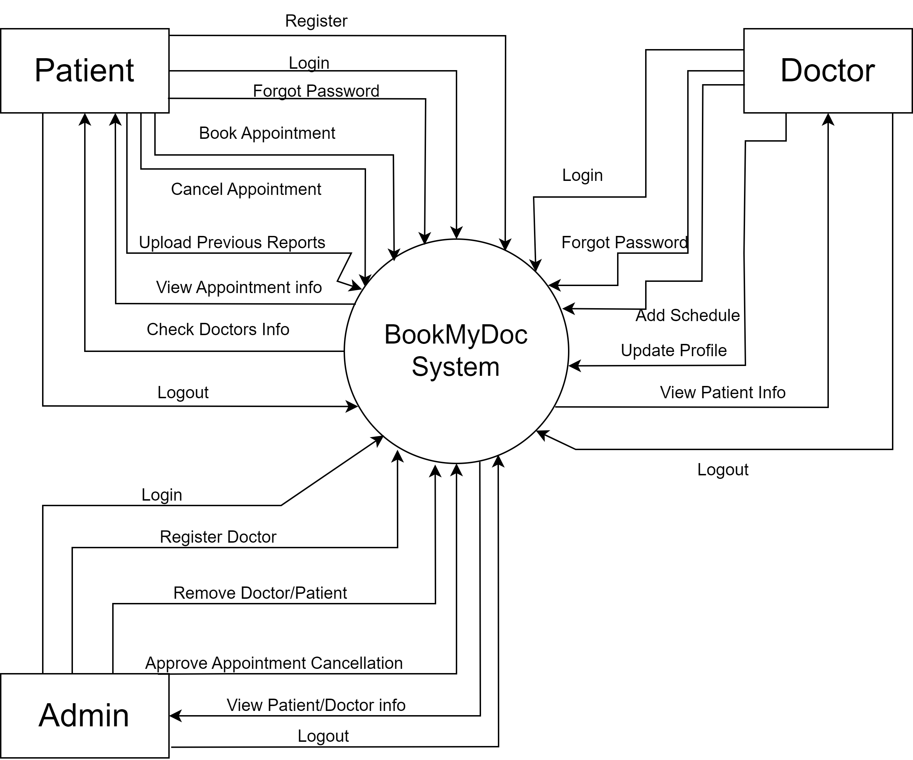
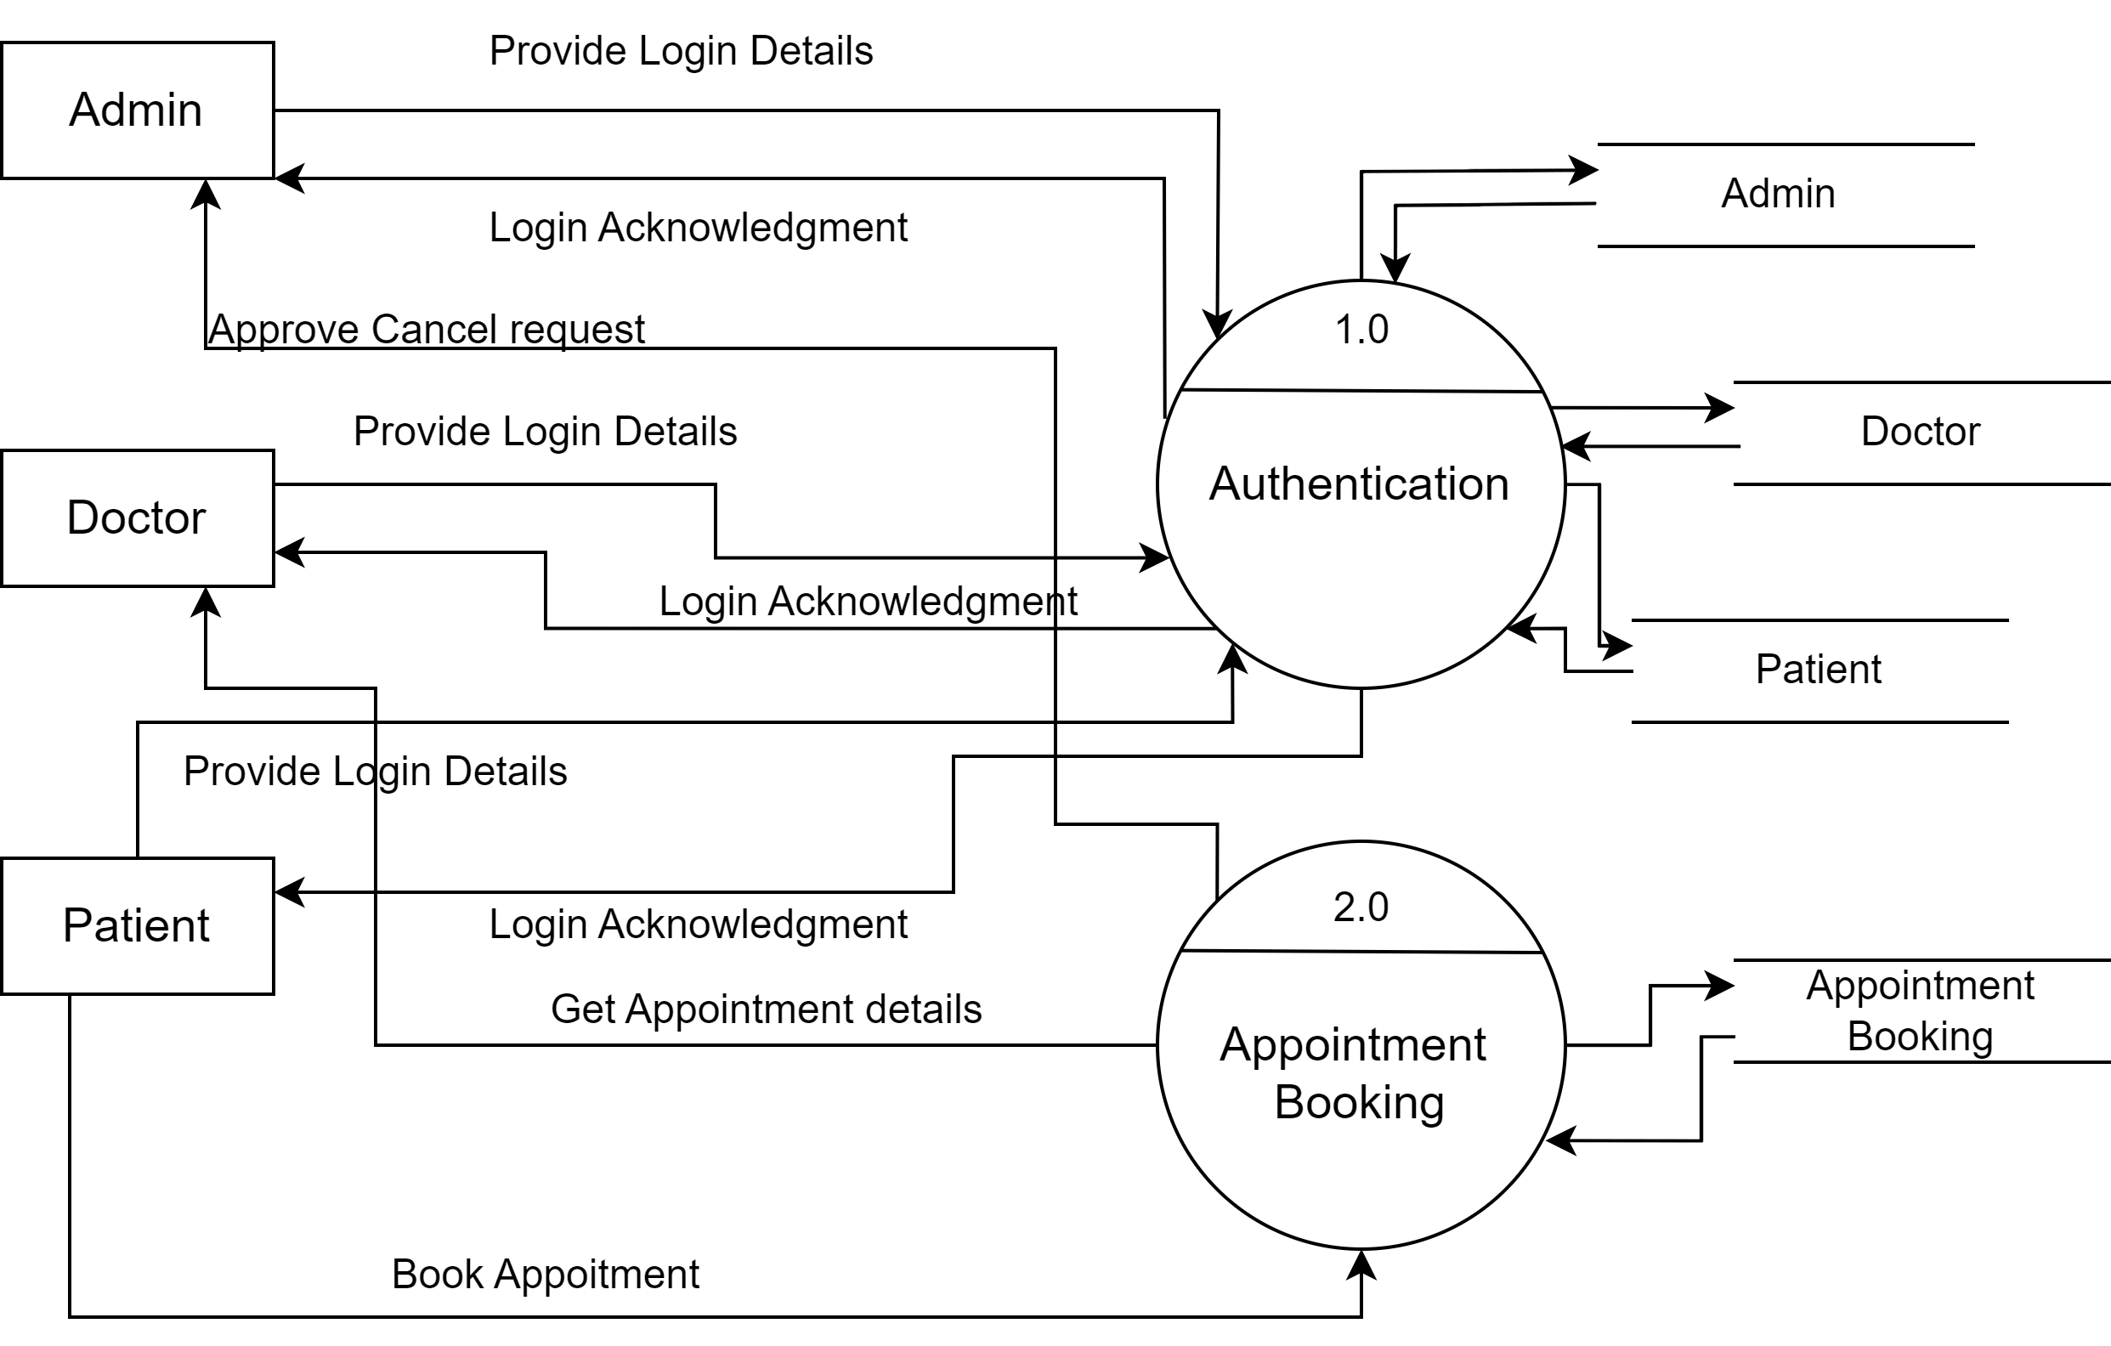
Data Flow Diagrams
0th level DFD
1th level DFD

Slide 11
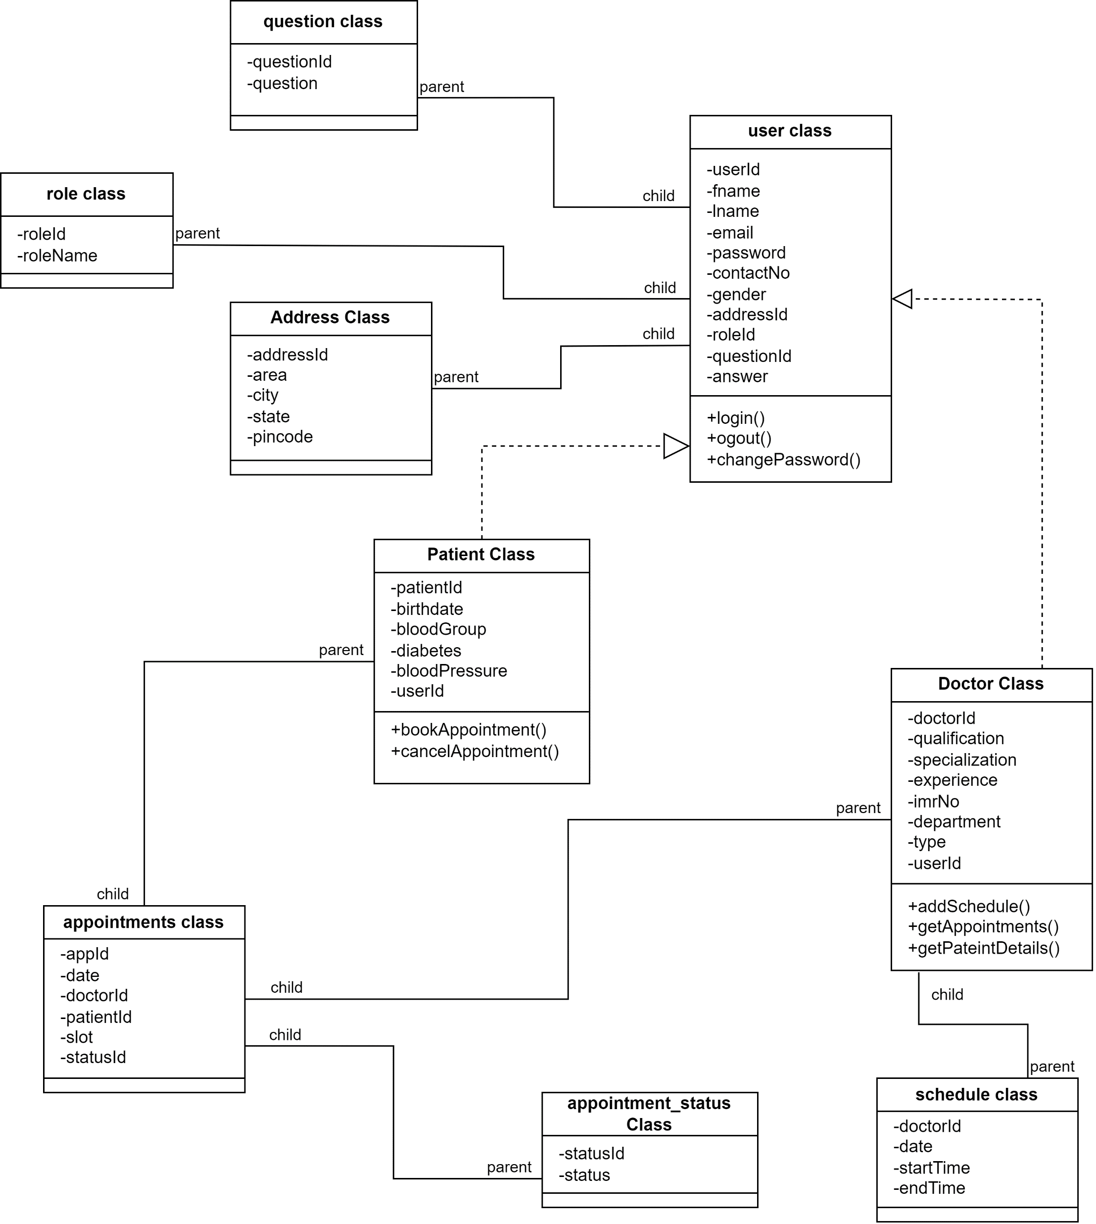
Class Diagram

Slide 12
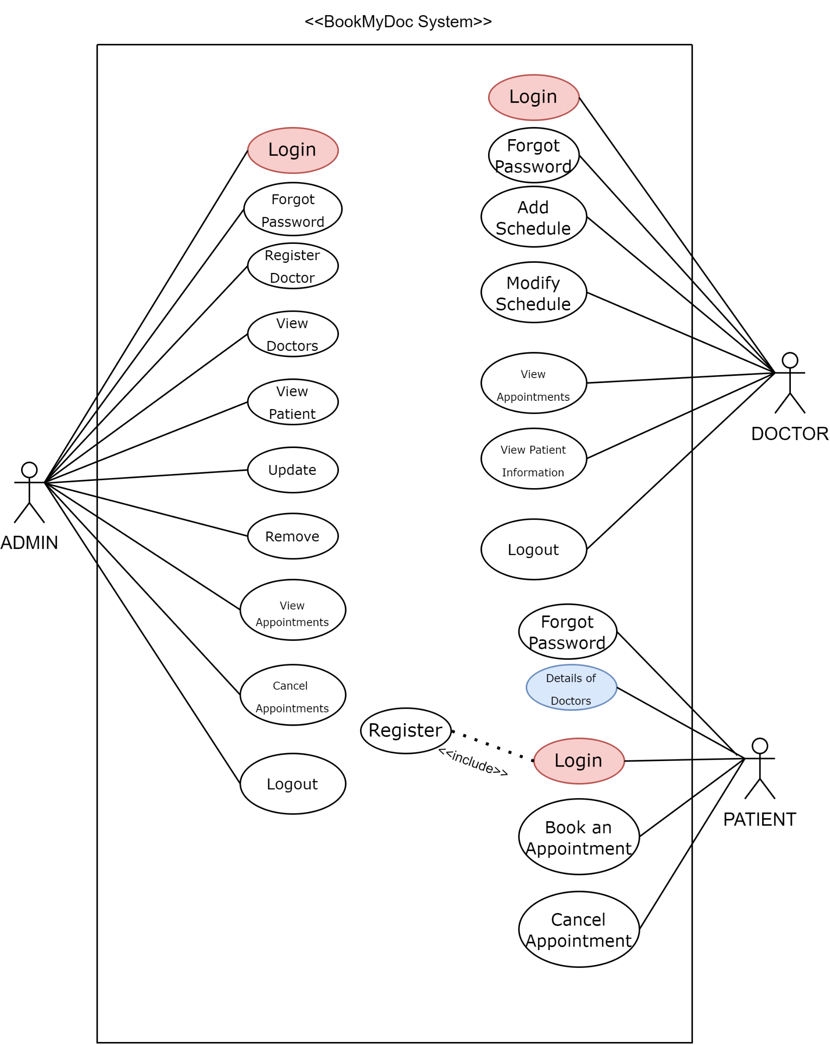
Use Case Diagrams

Slide 13
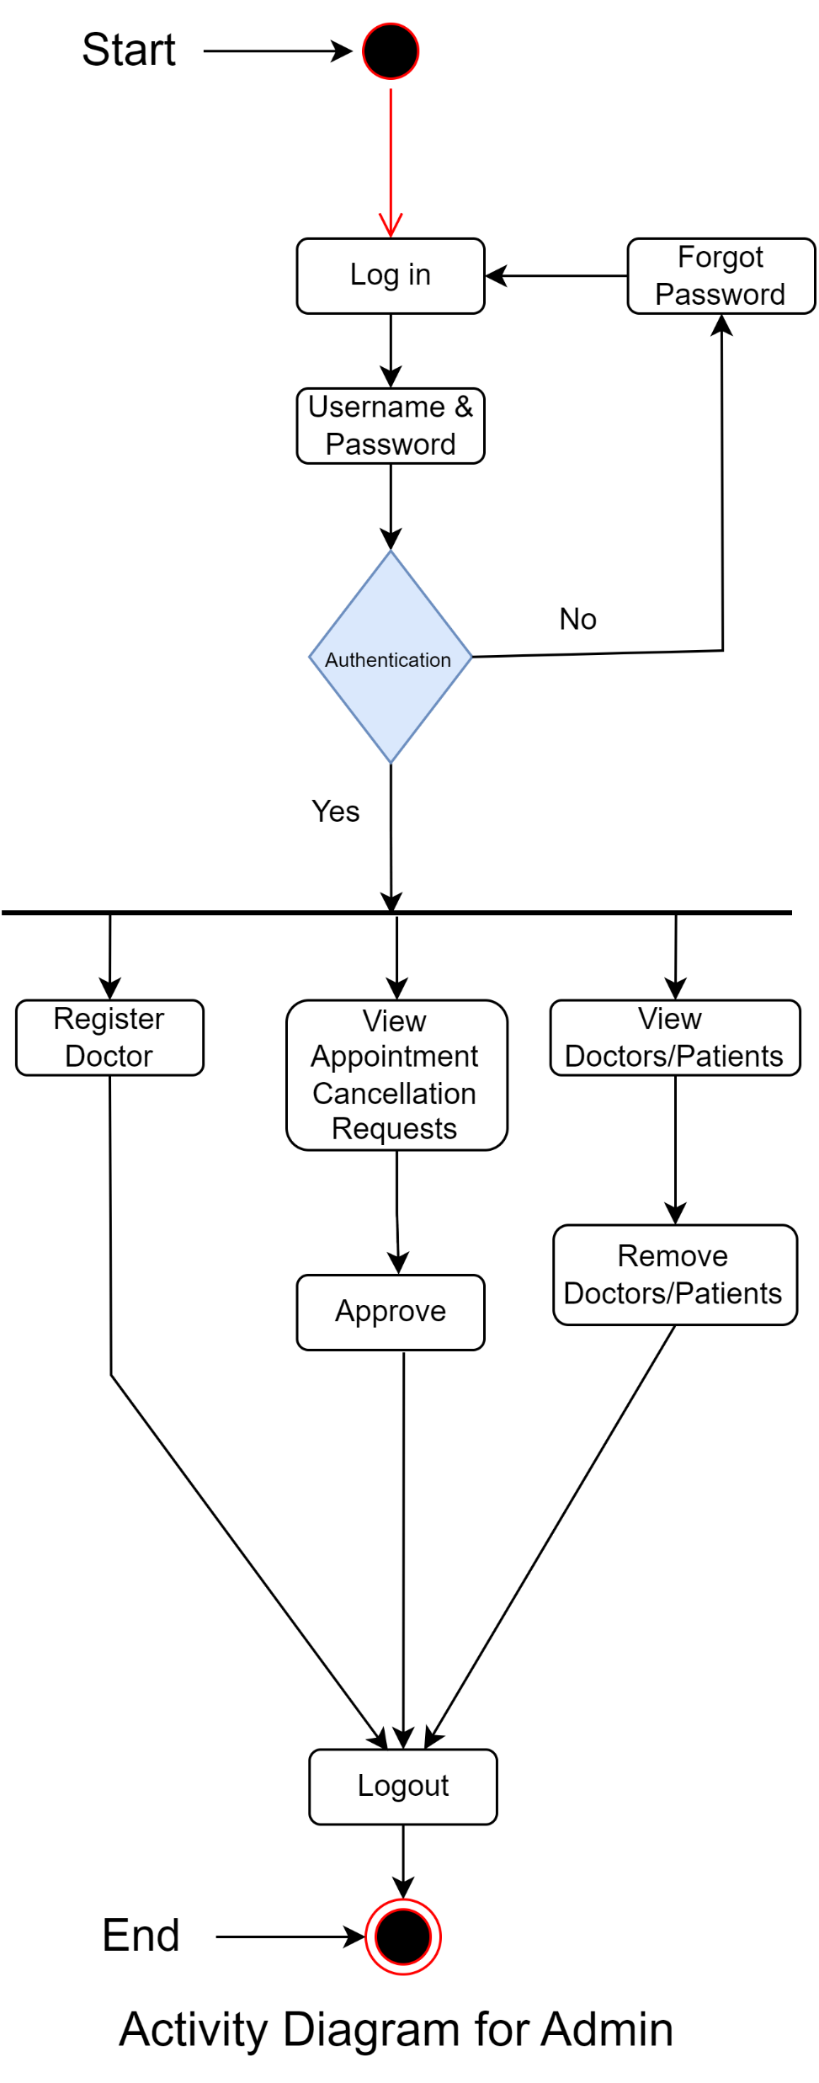
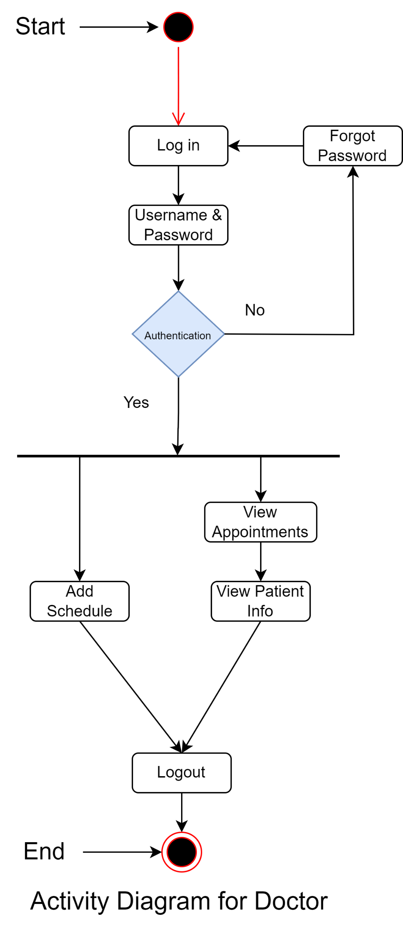
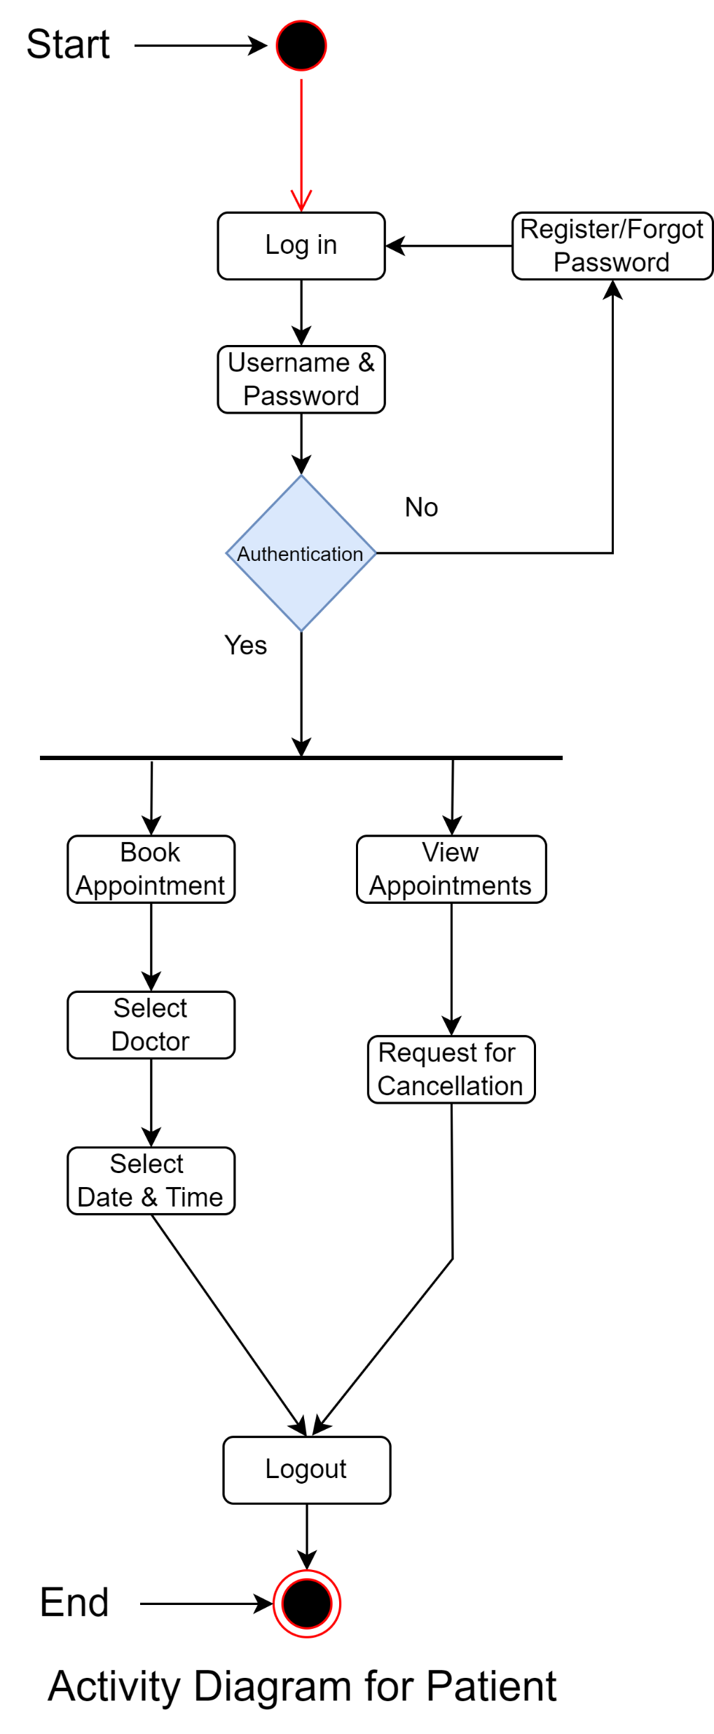
Activity Diagrams

Slide 14
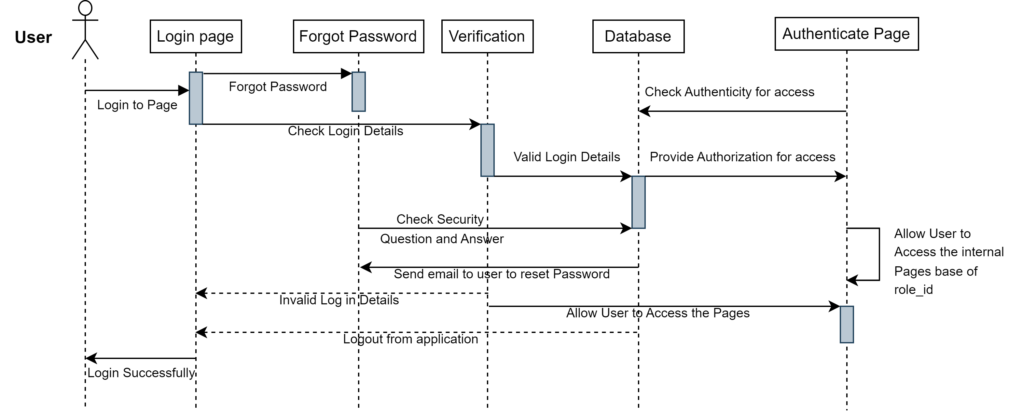
Sequence Diagram

Slide 15
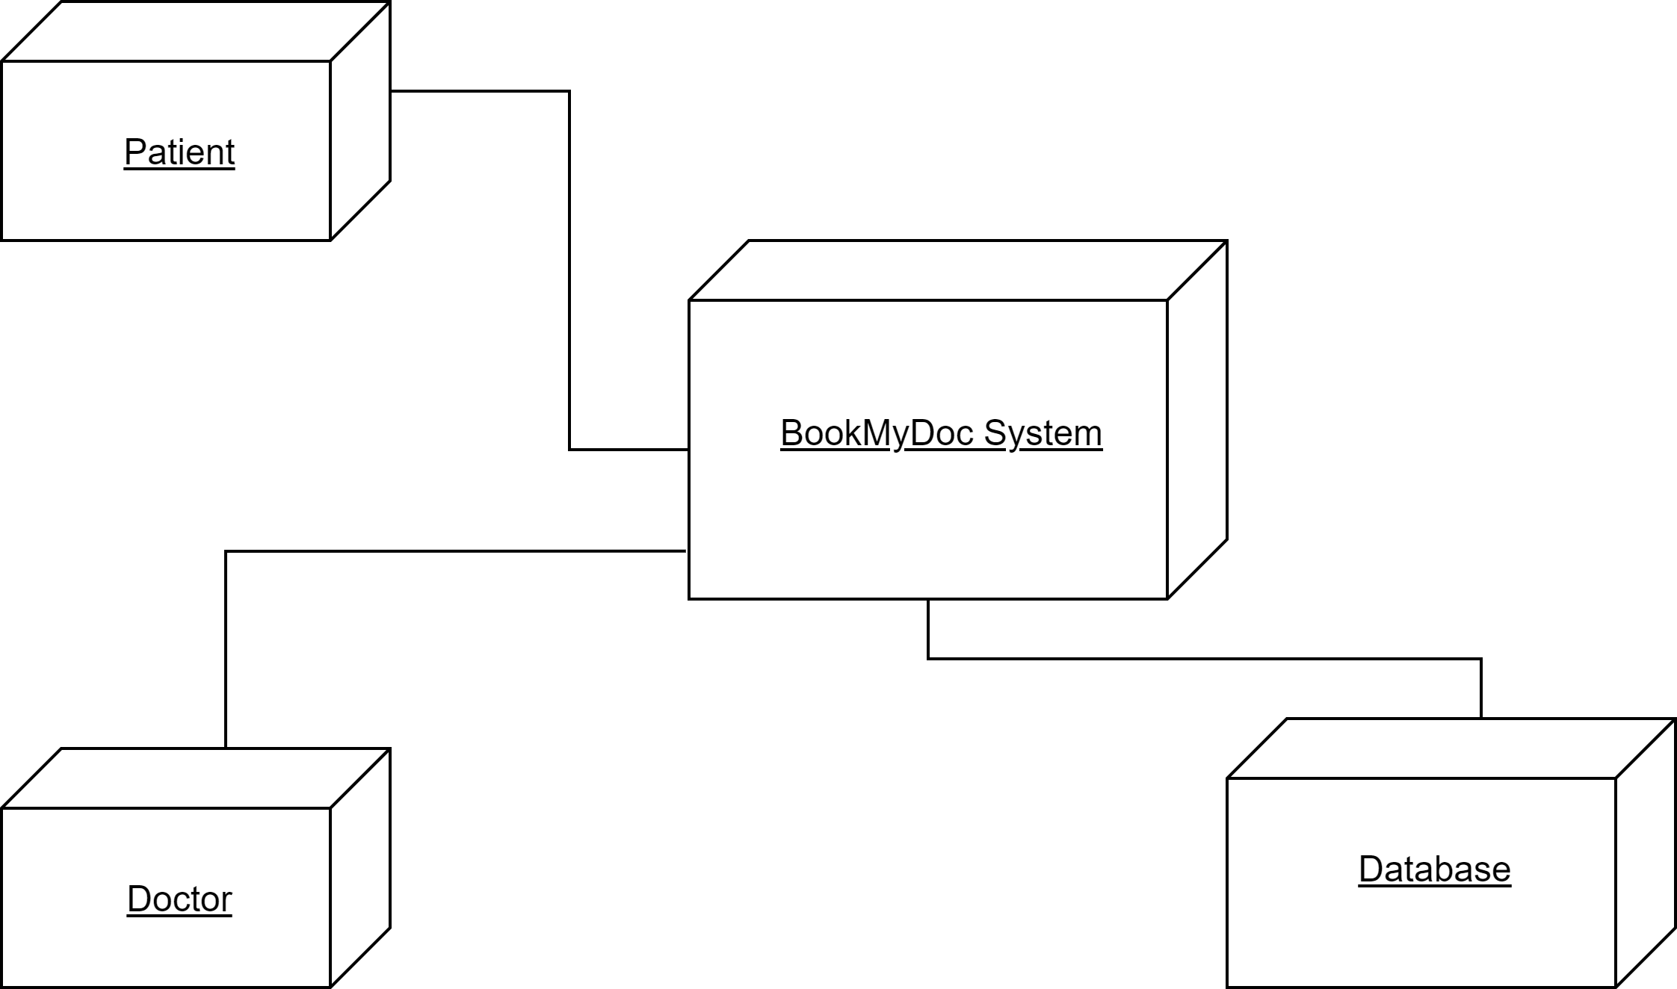
Deployment Diagram

Slide 16
Anonymous User

Slide 17
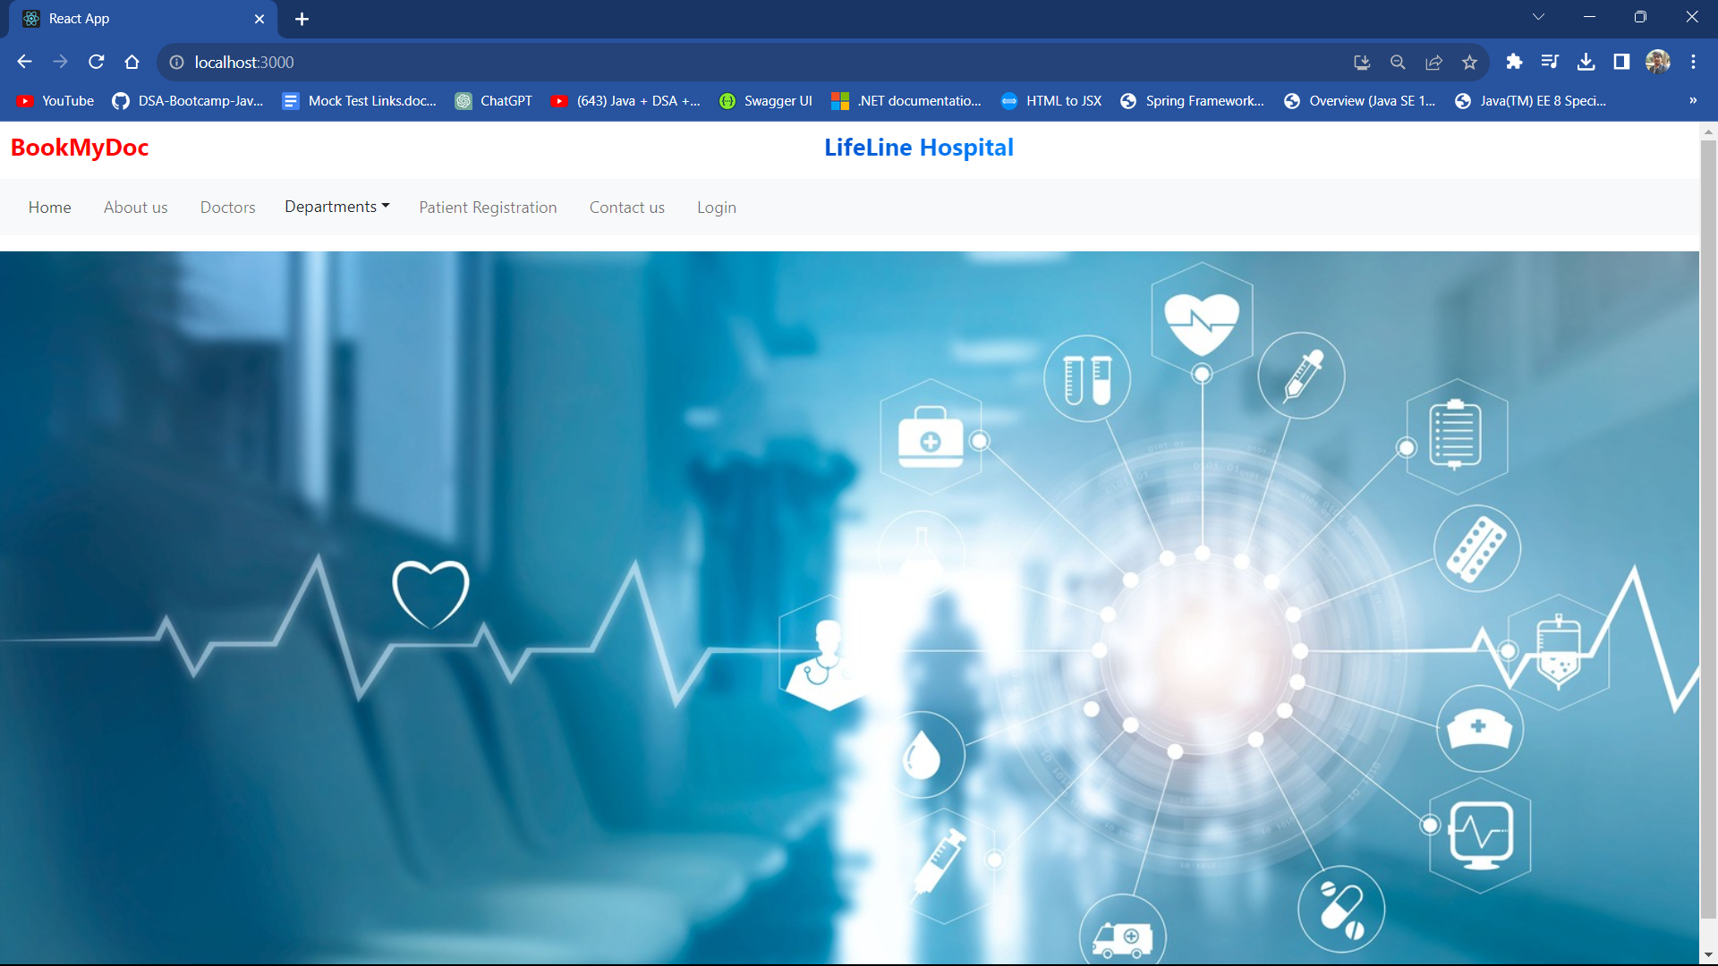

Slide 18
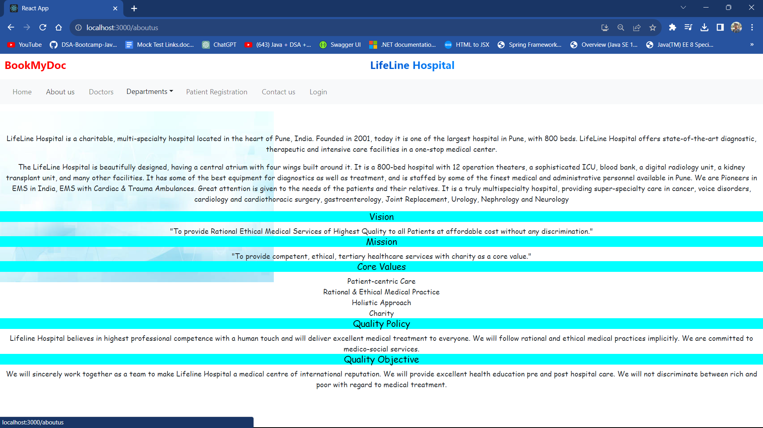

Slide 19
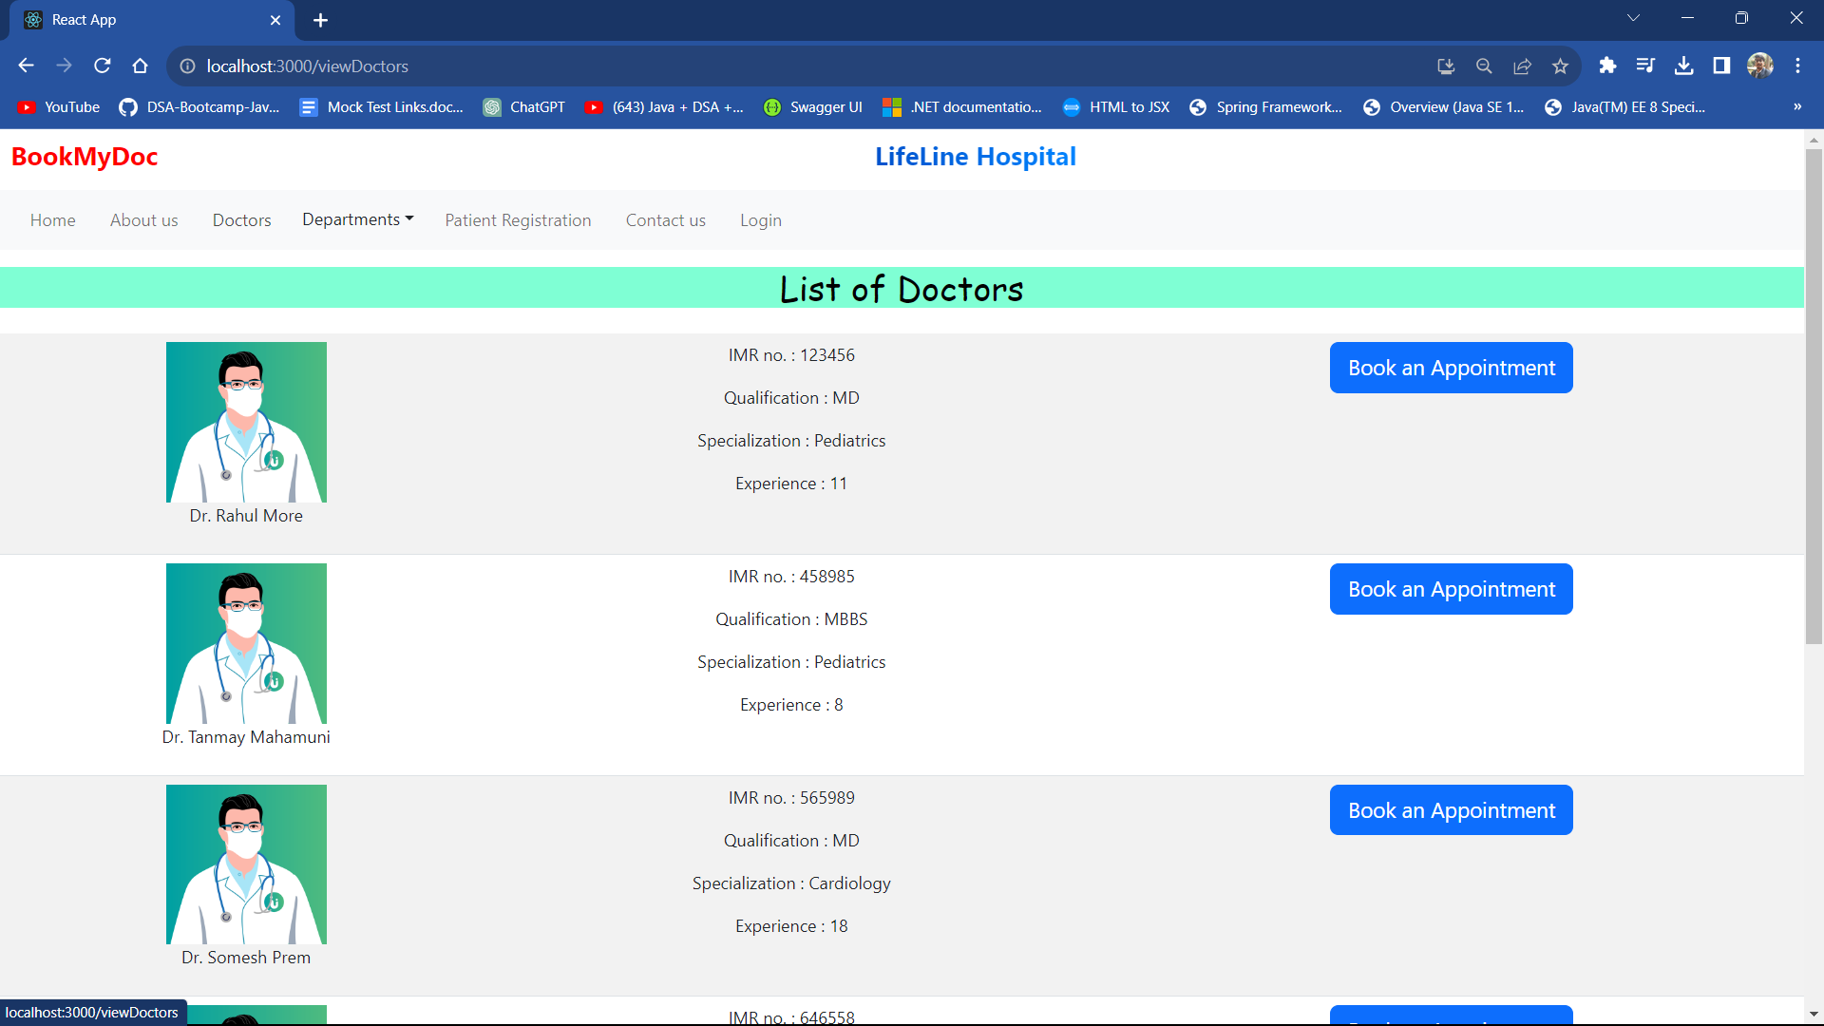

Slide 20
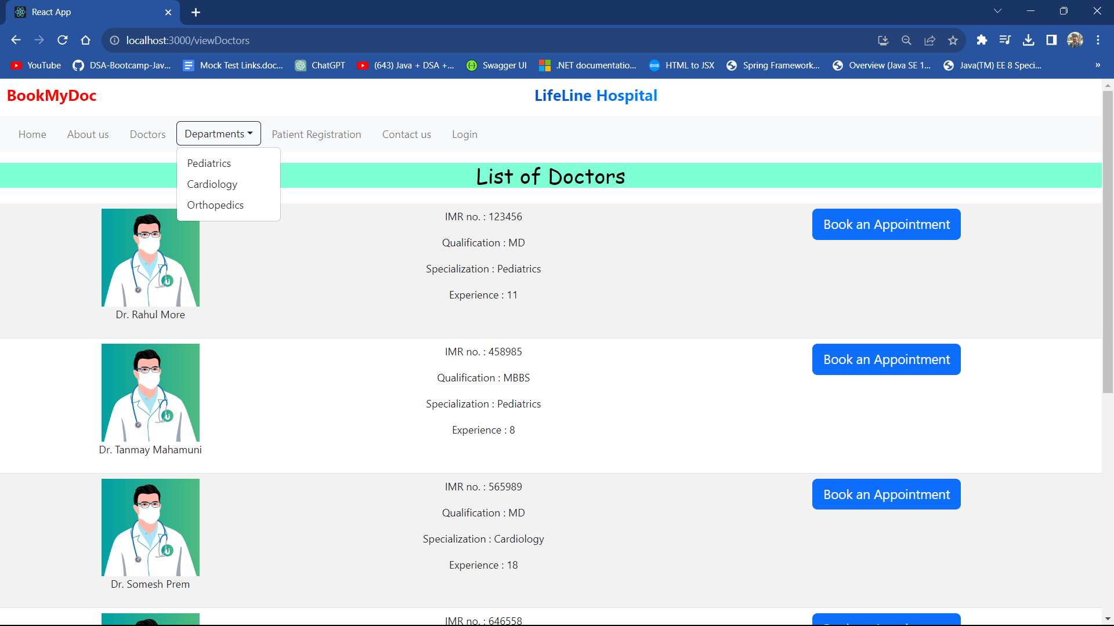

Slide 21
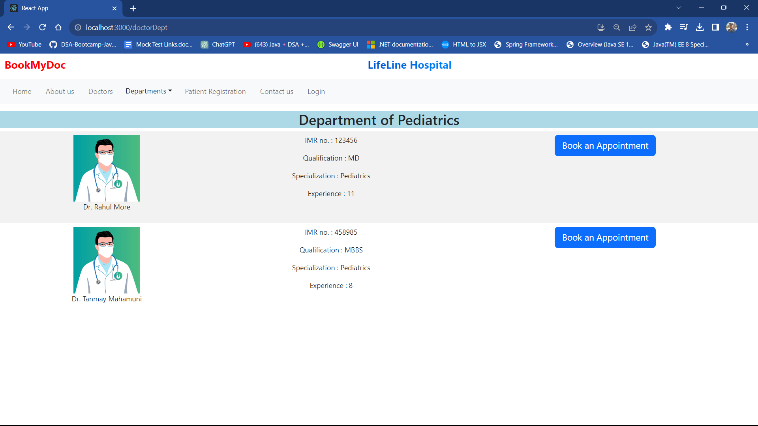

Slide 22


Slide 23


Slide 24
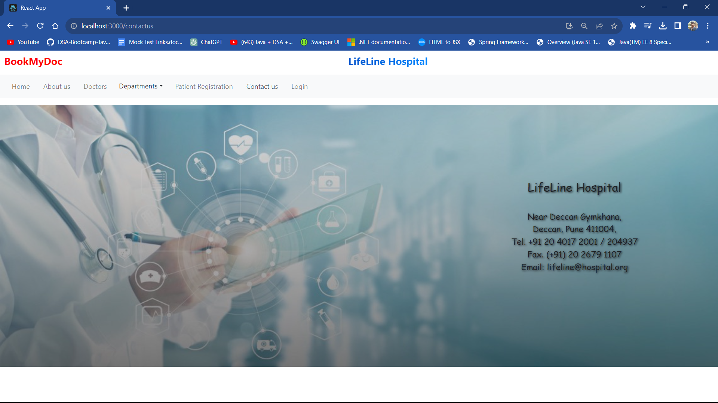

Slide 25
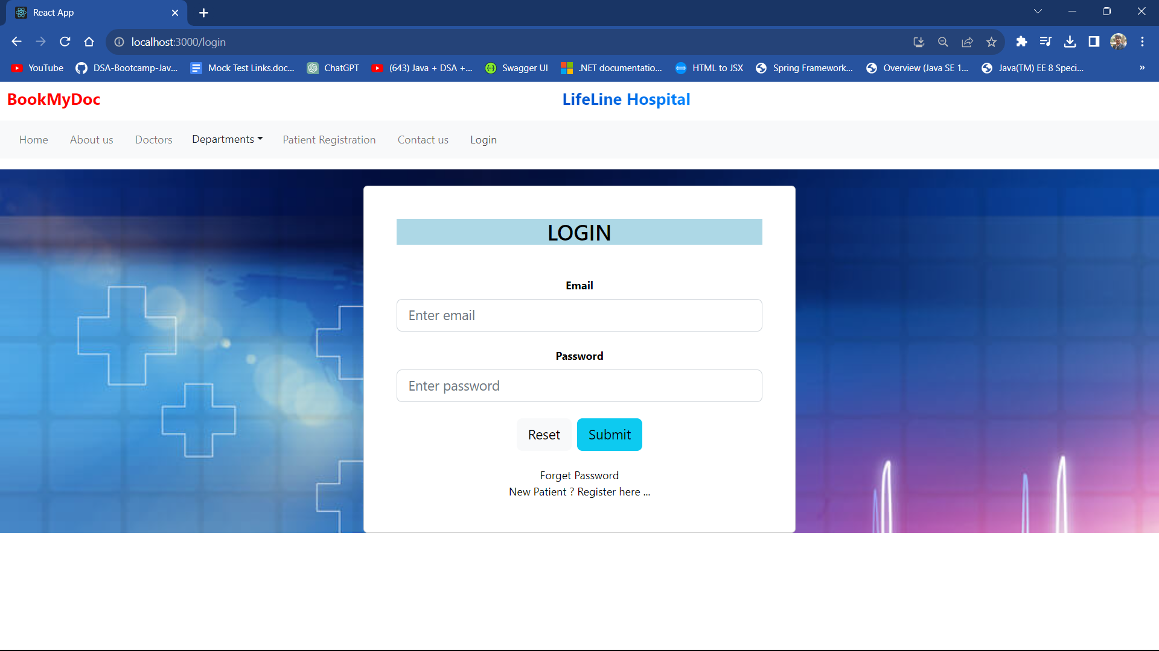

Slide 26
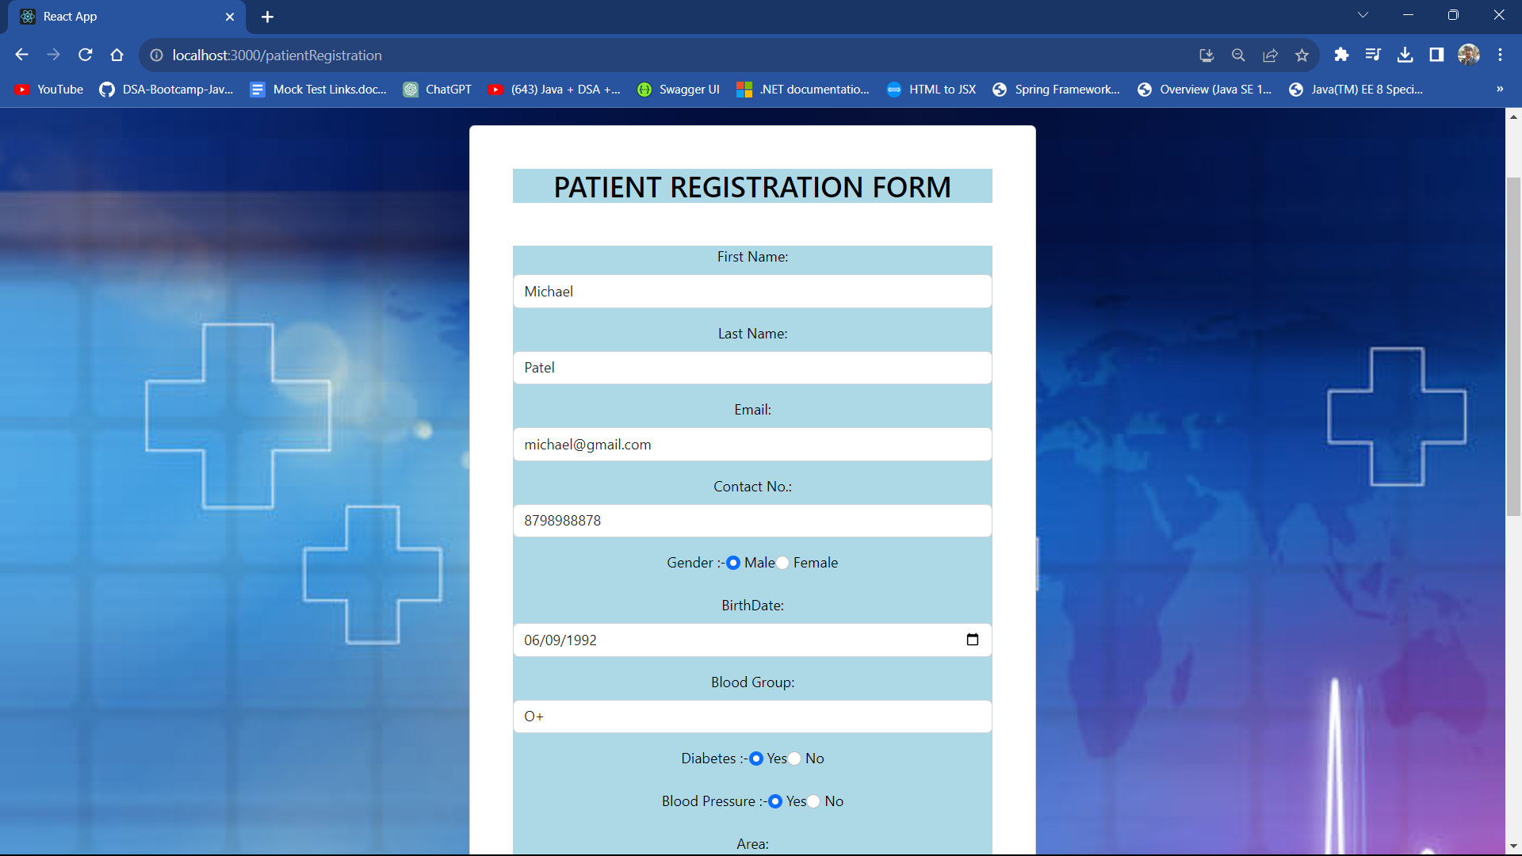

Slide 27
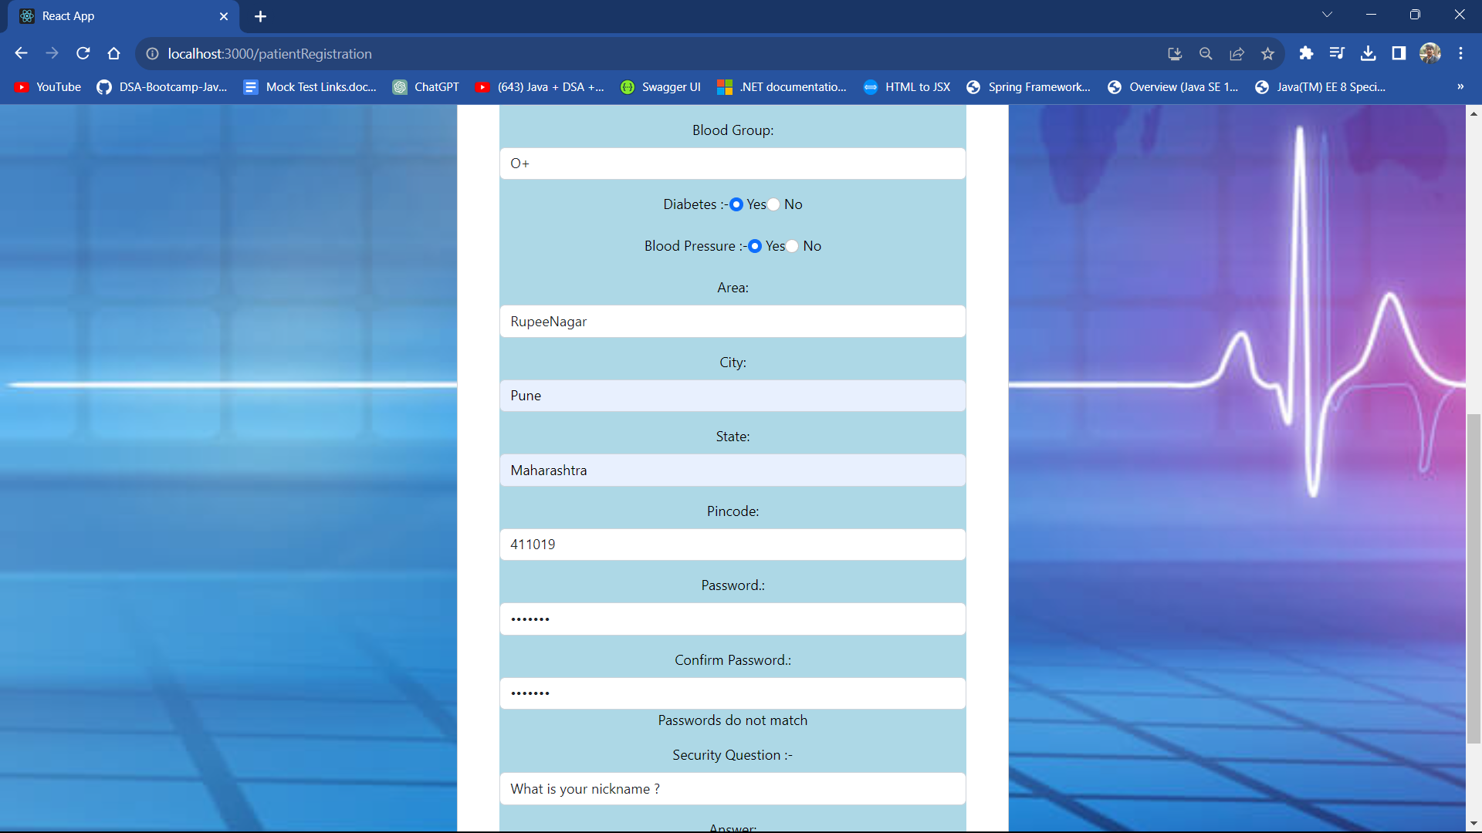

Slide 28
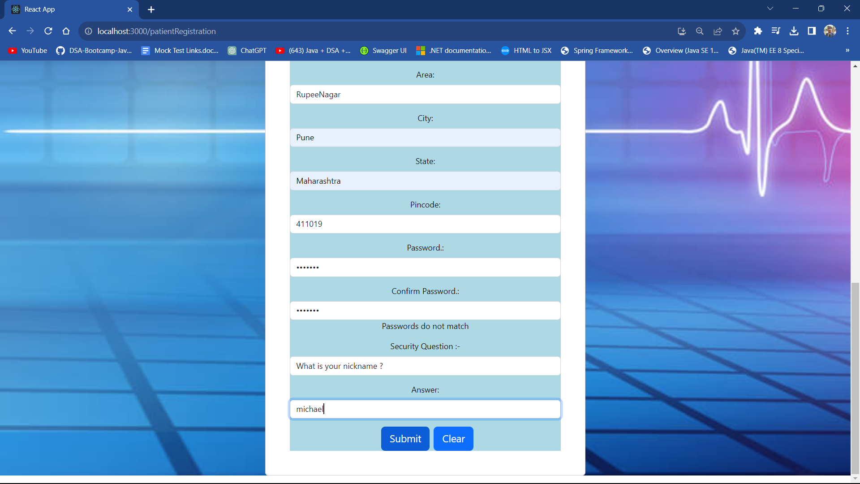

Slide 29
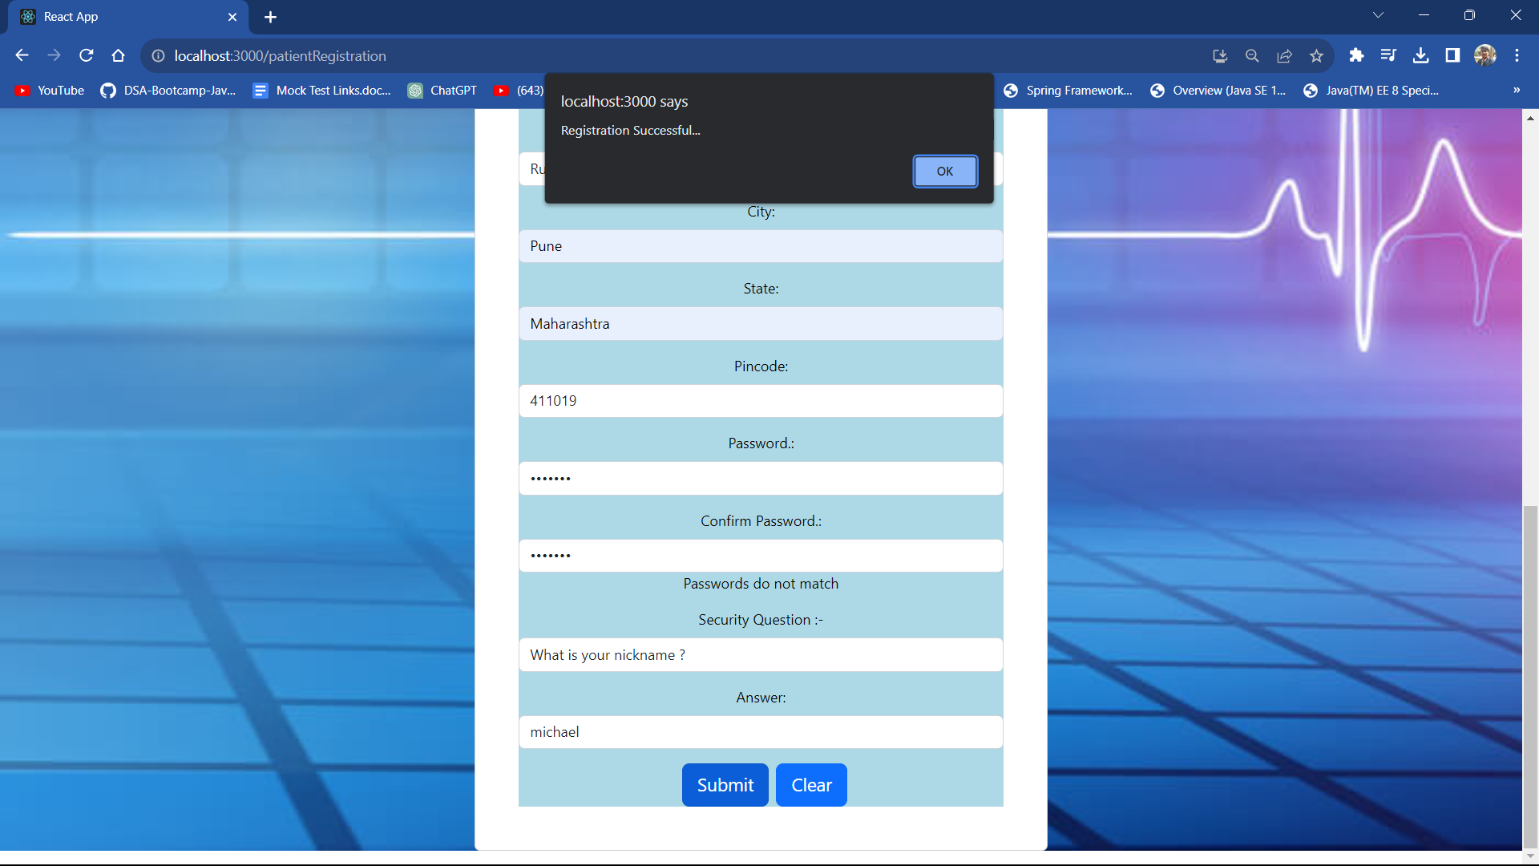

Slide 30
Doctor Login

Slide 31
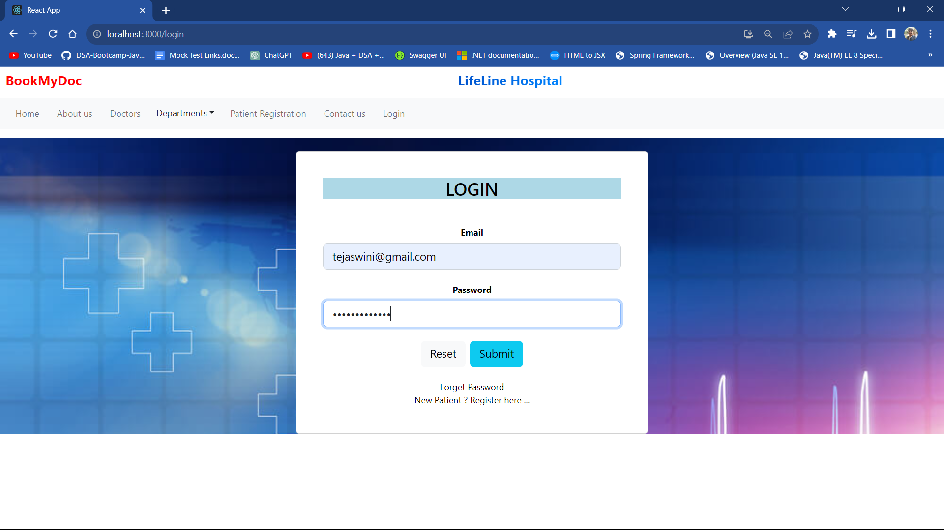

Slide 32
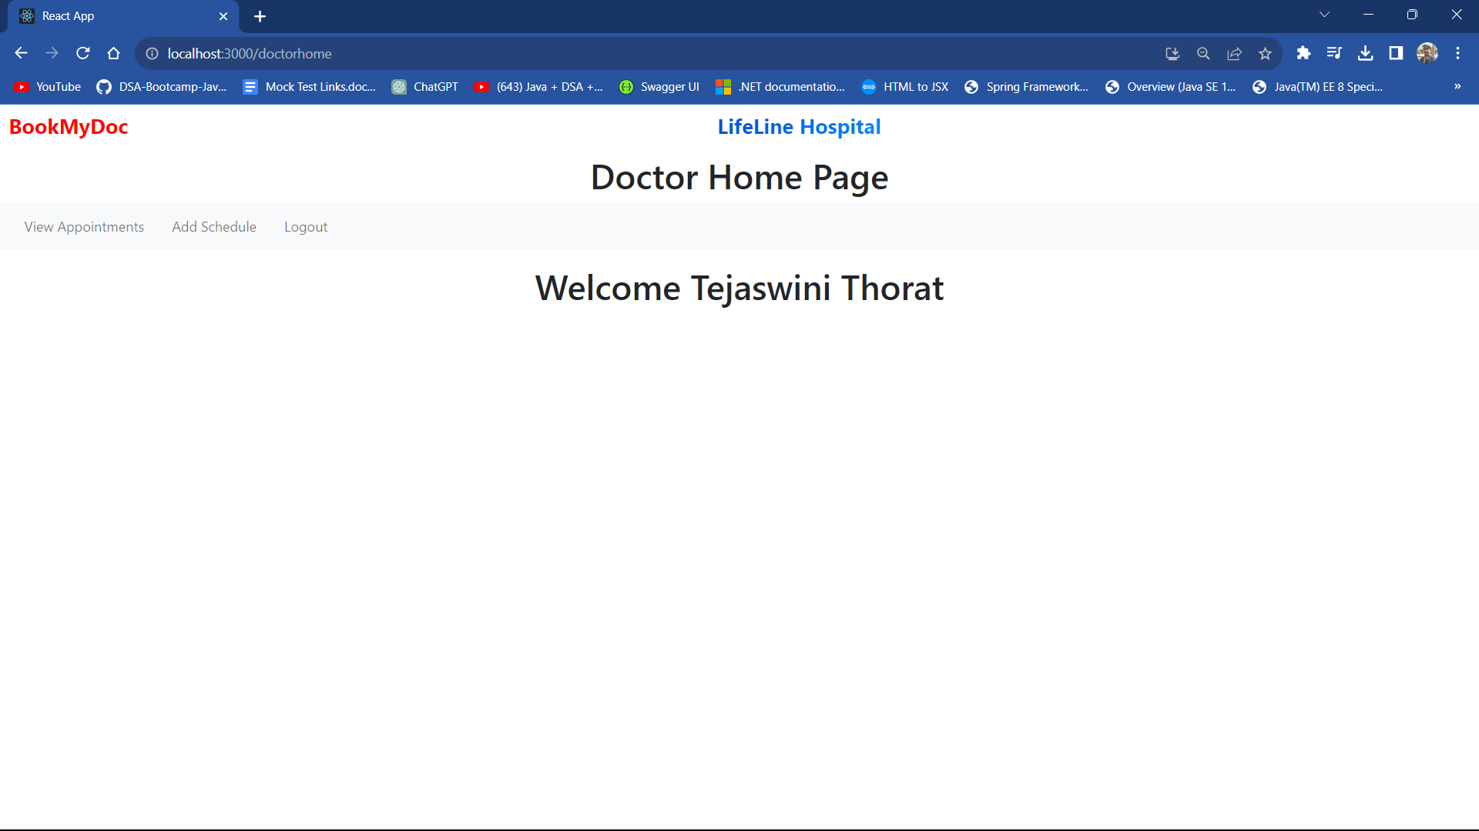

Slide 33
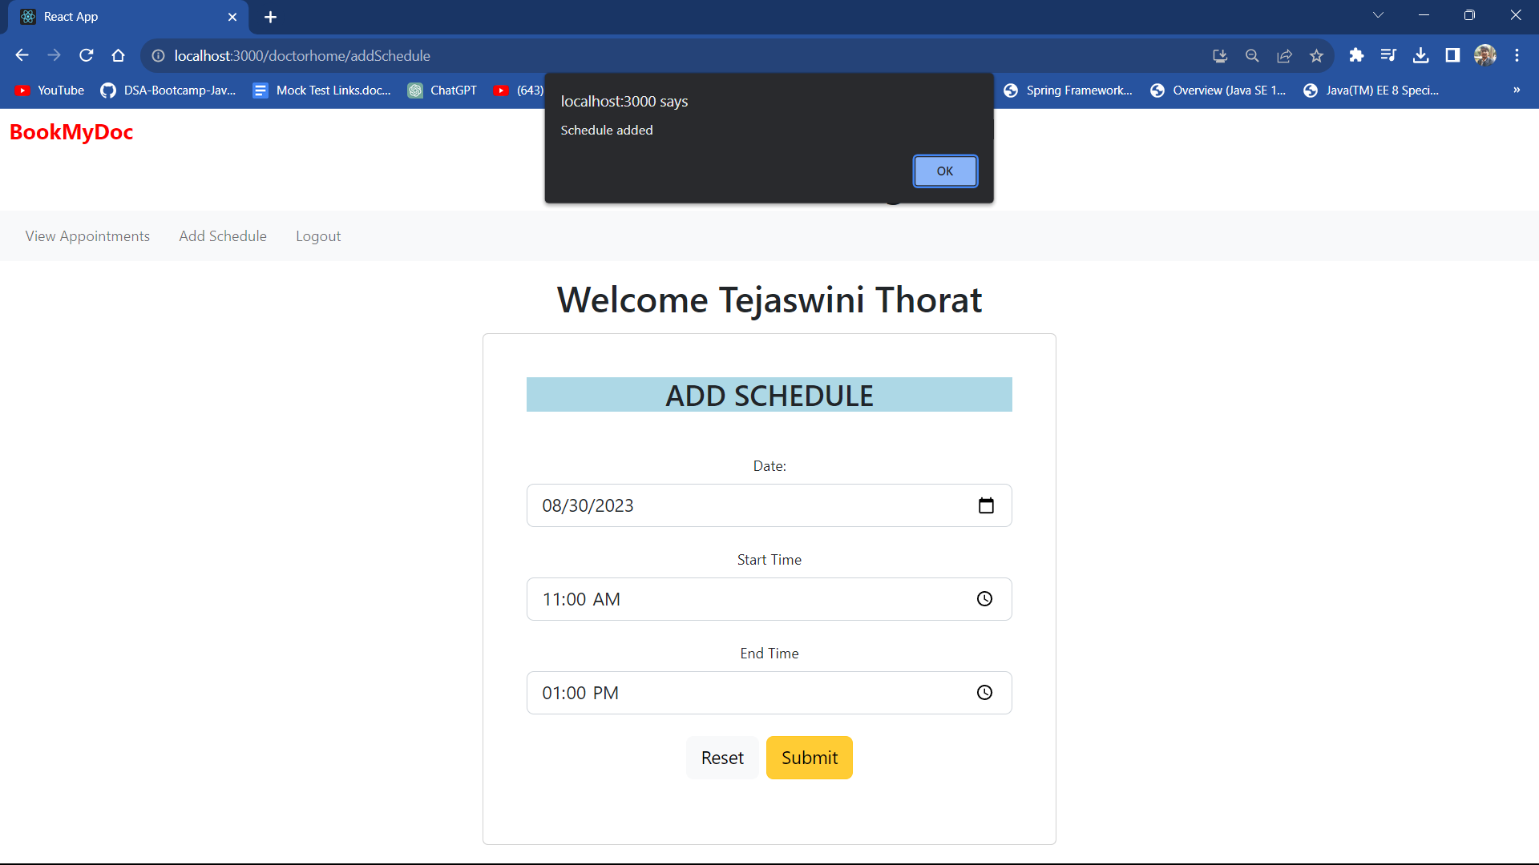

Slide 34
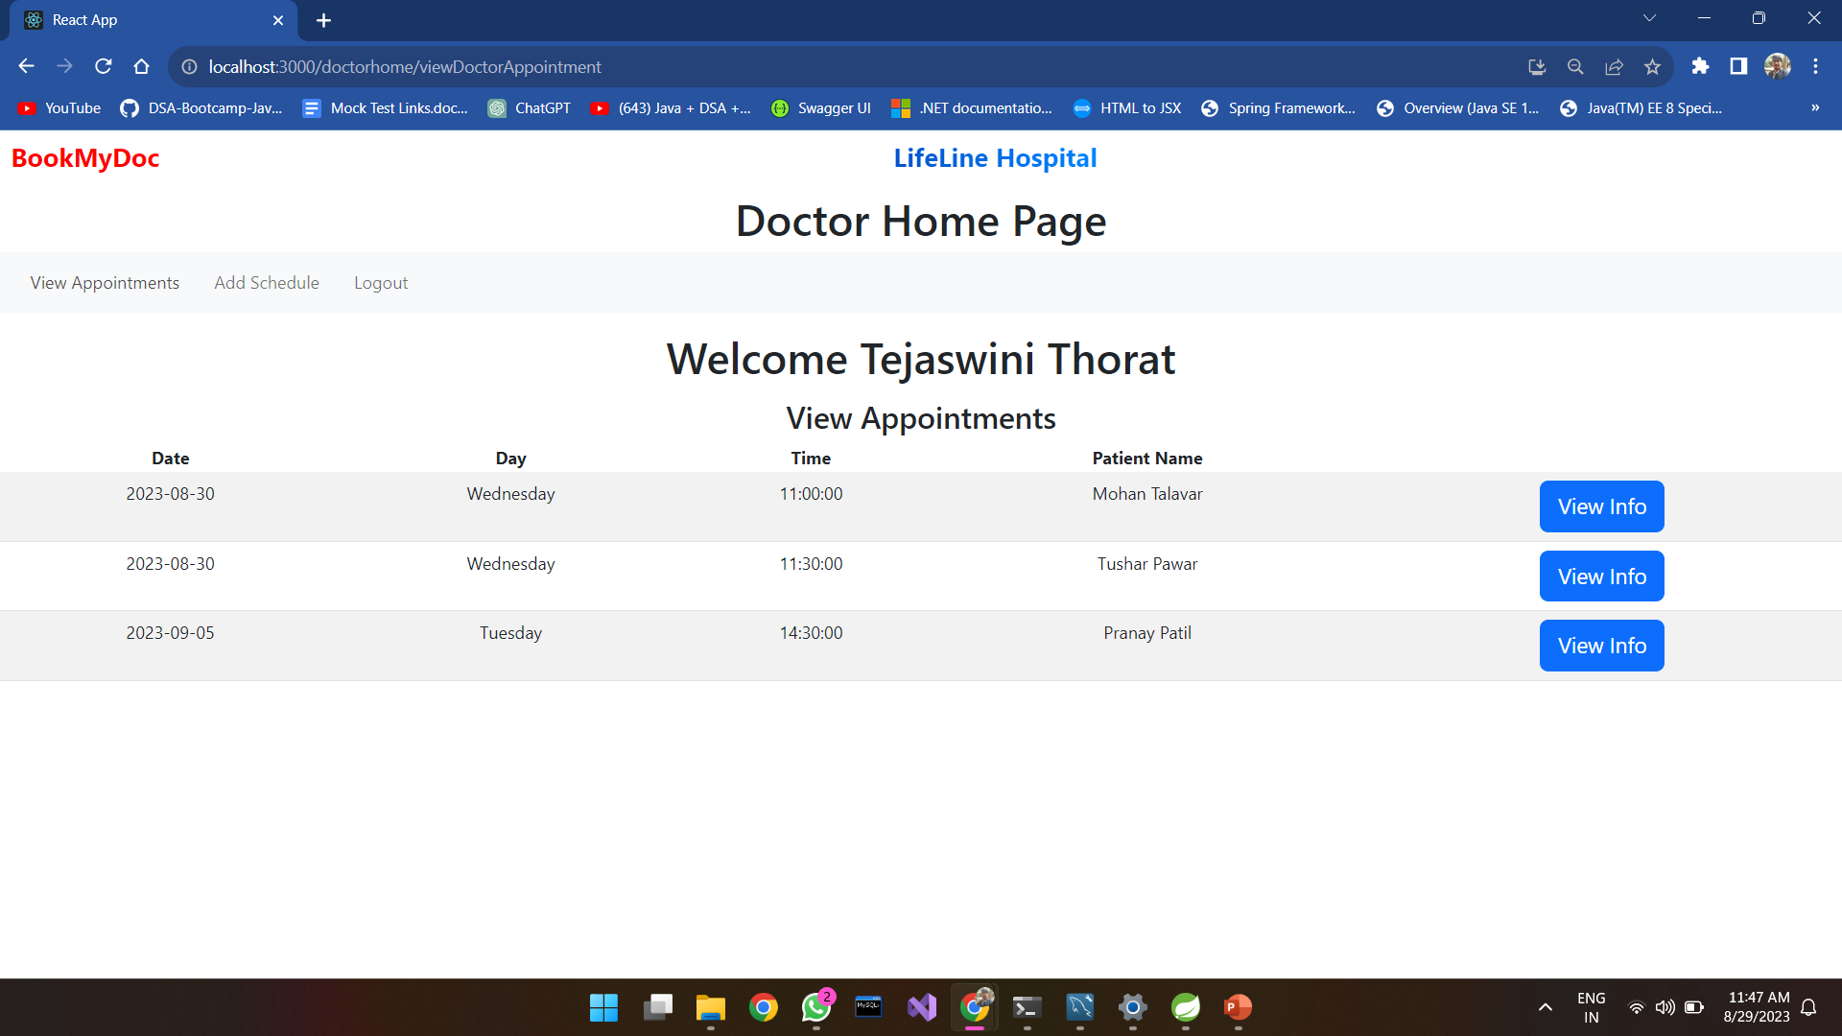

Slide 35
Patient Login

Slide 36
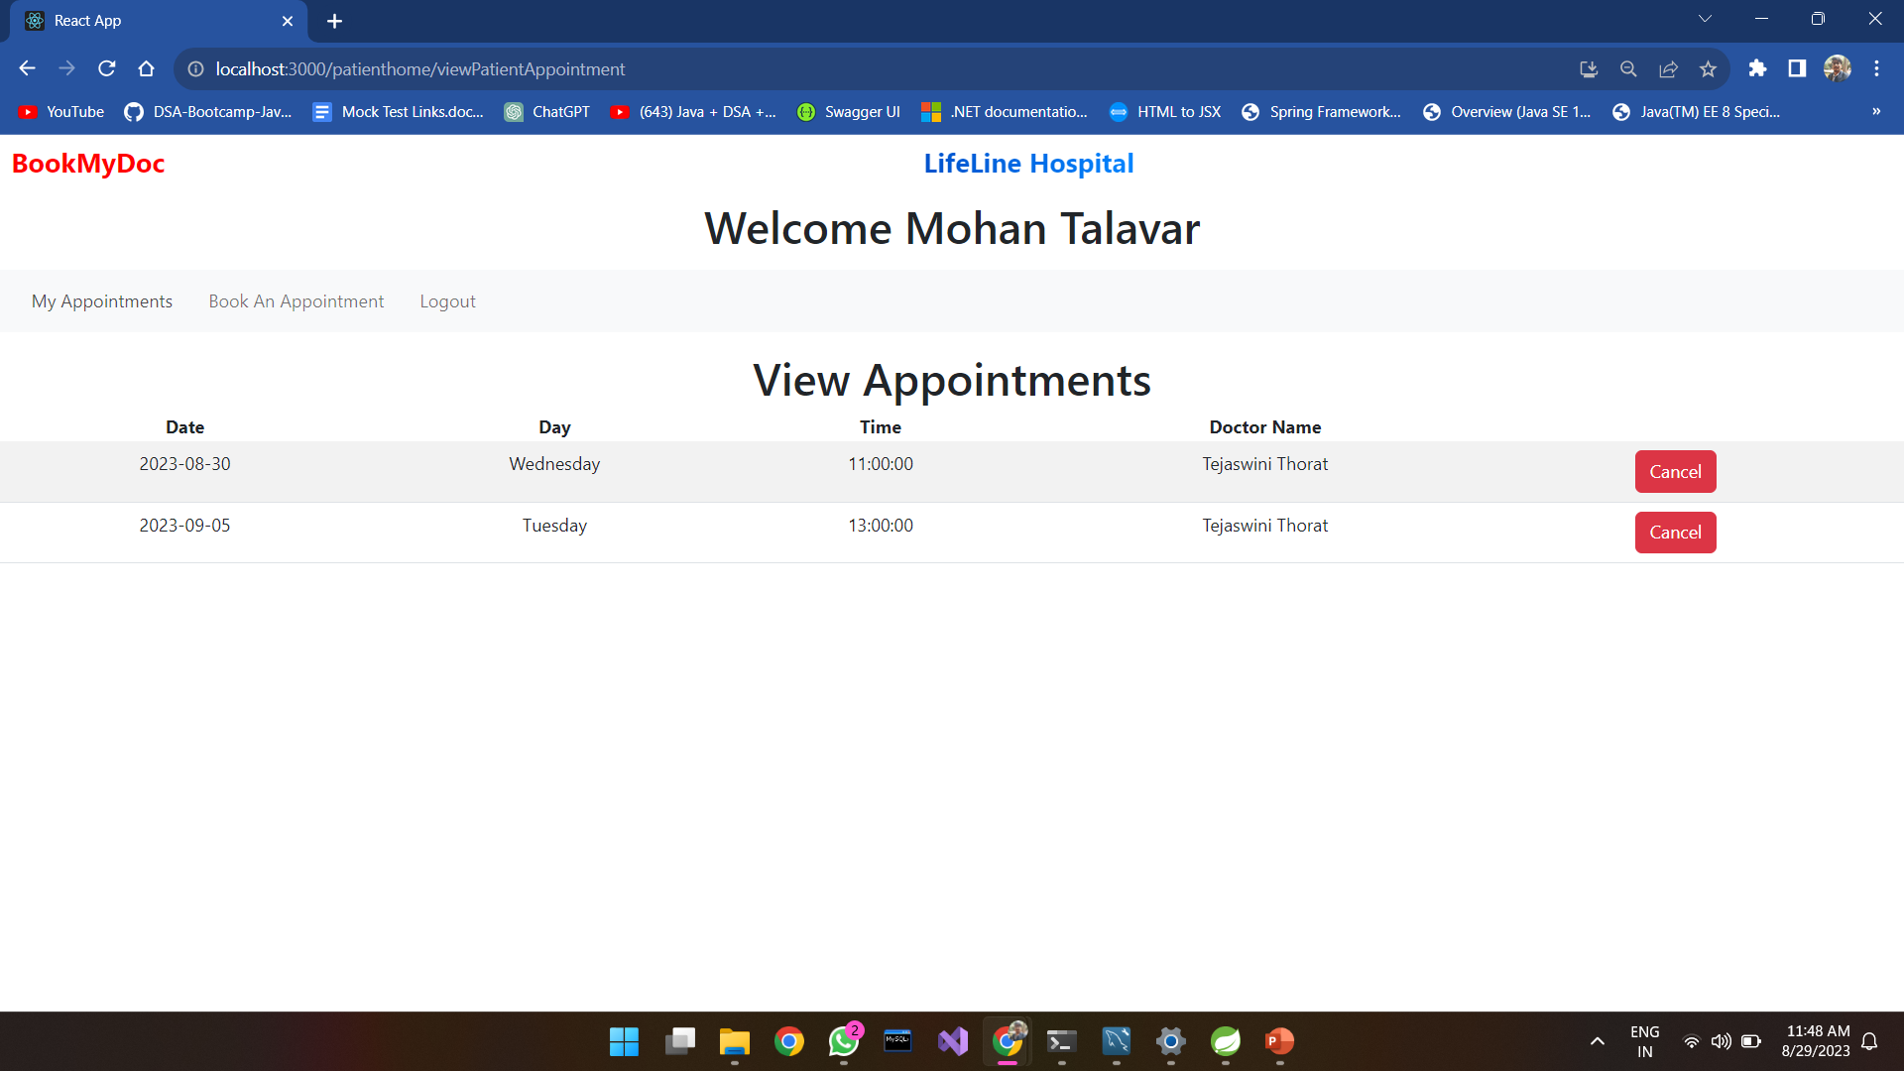

Slide 37
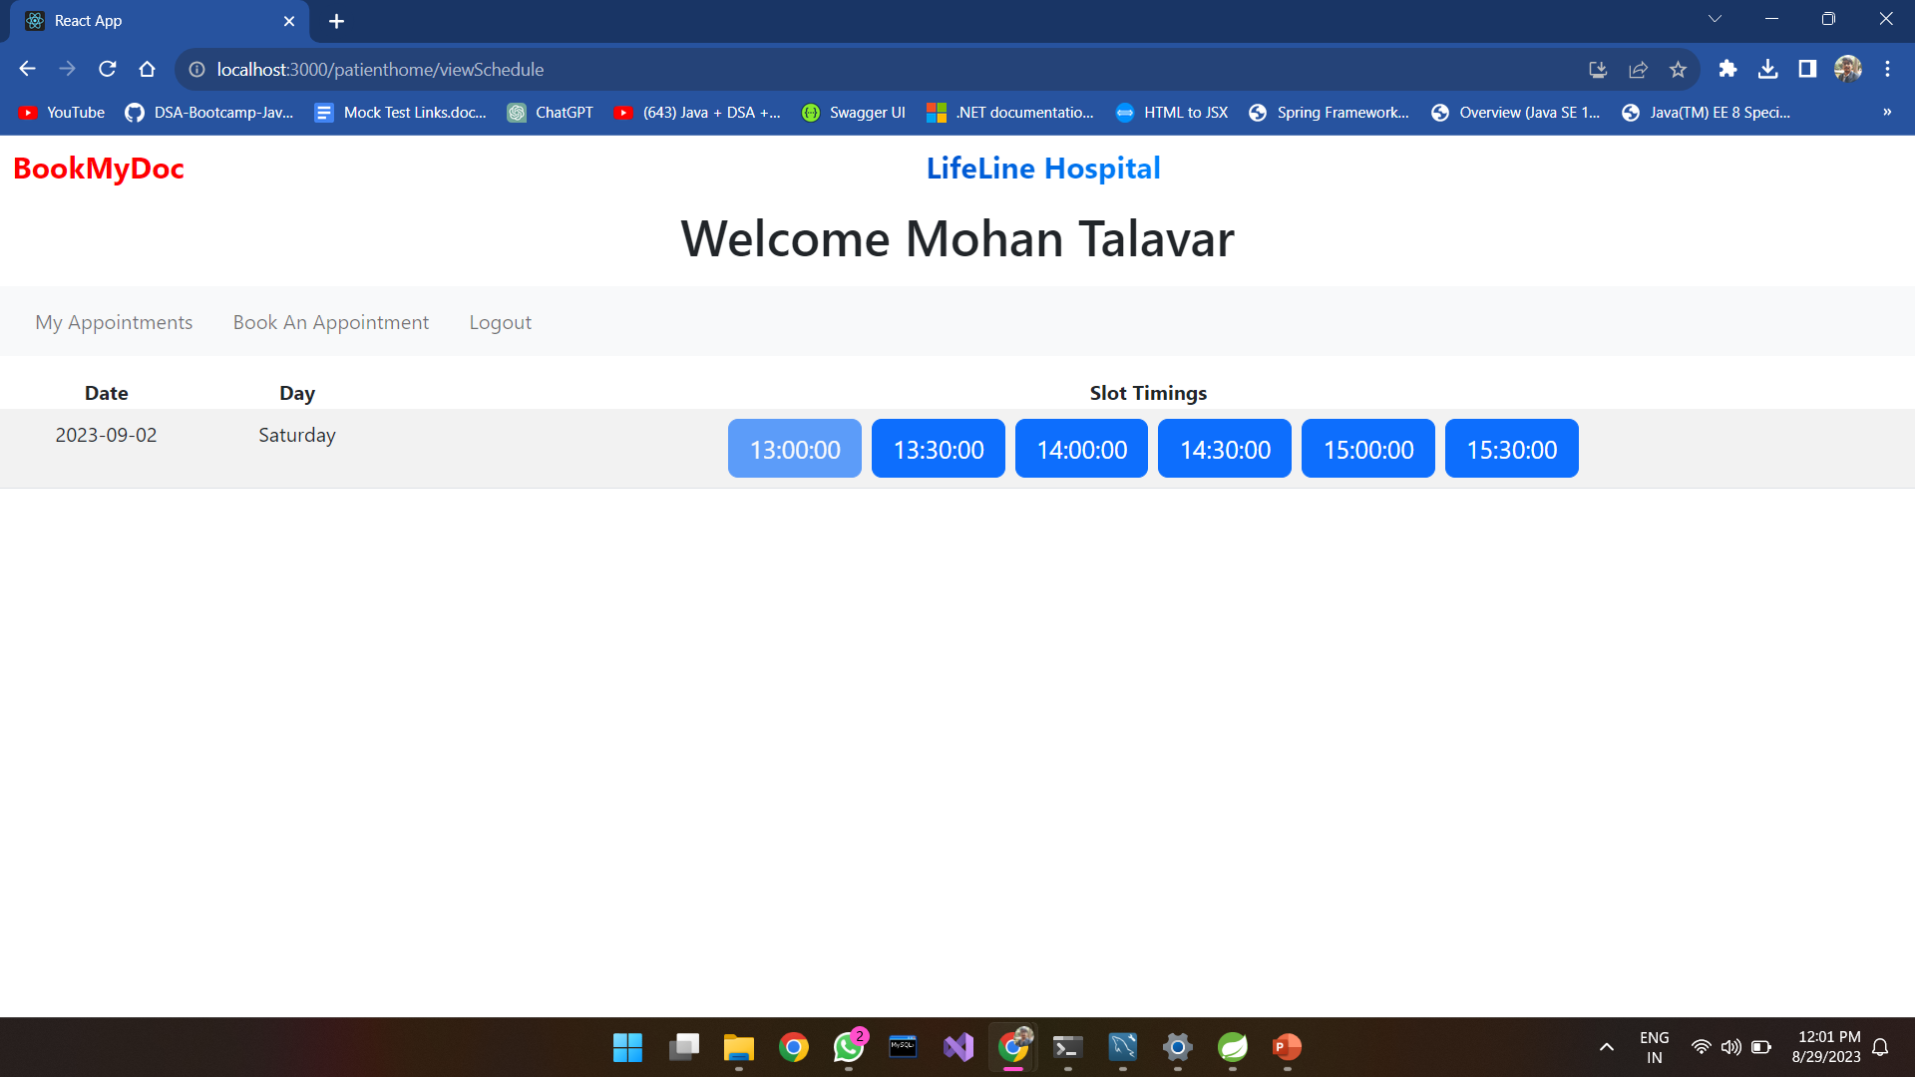

Slide 38
Admin Login

Slide 39
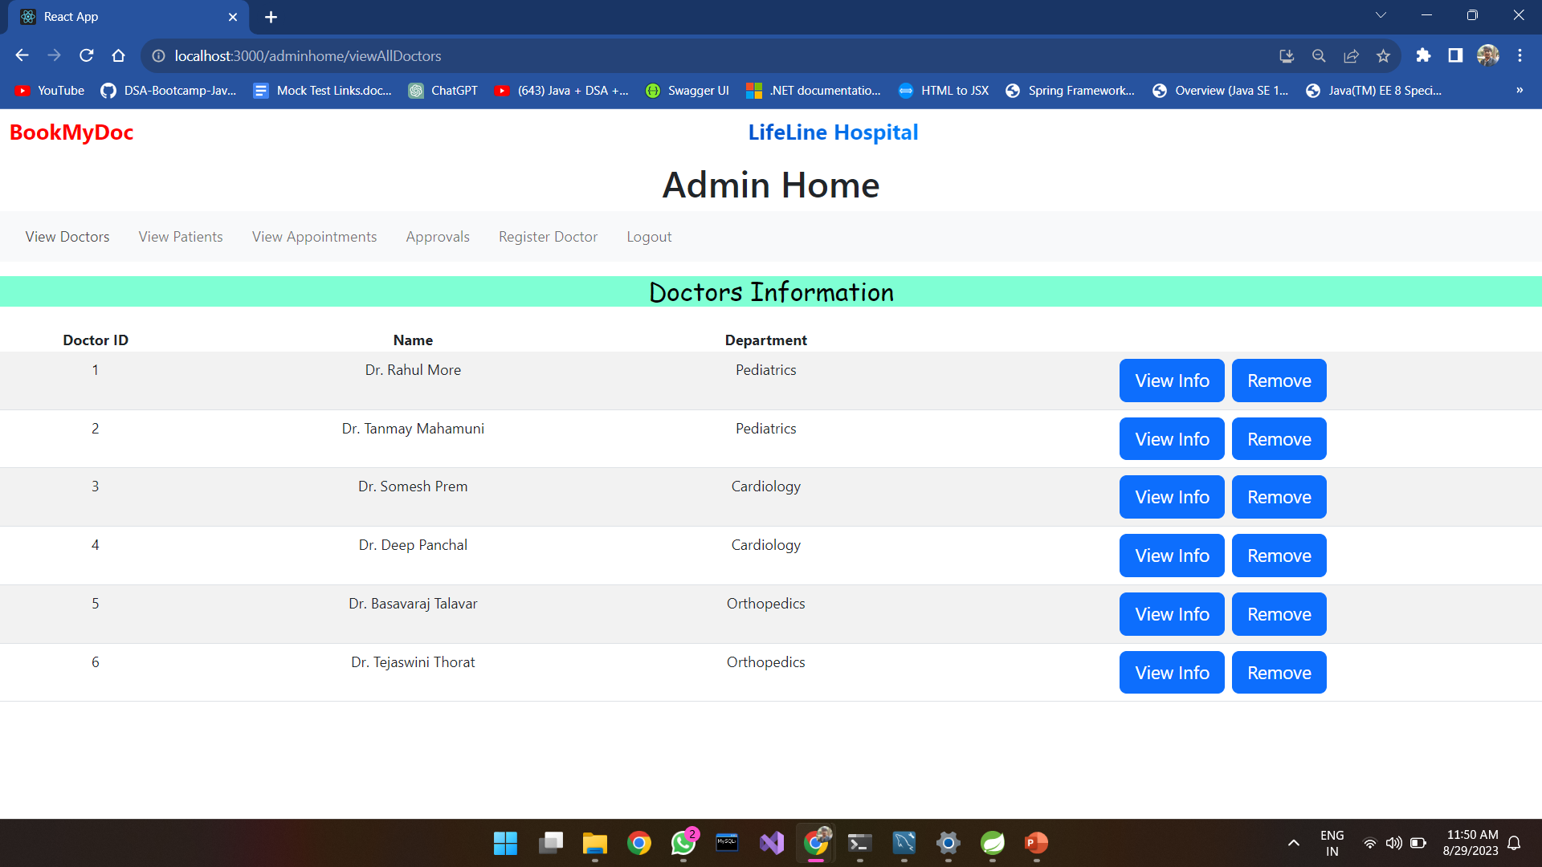

Slide 40
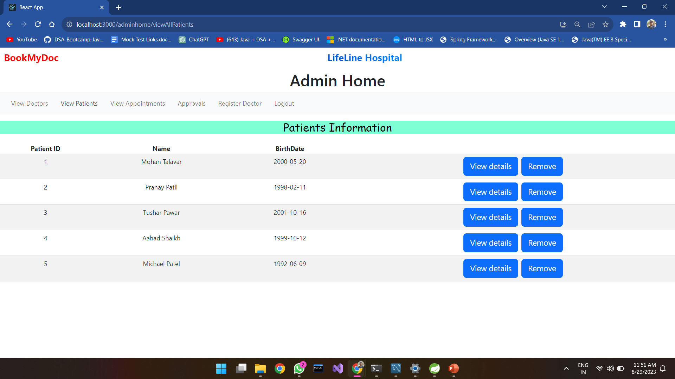

Slide 41
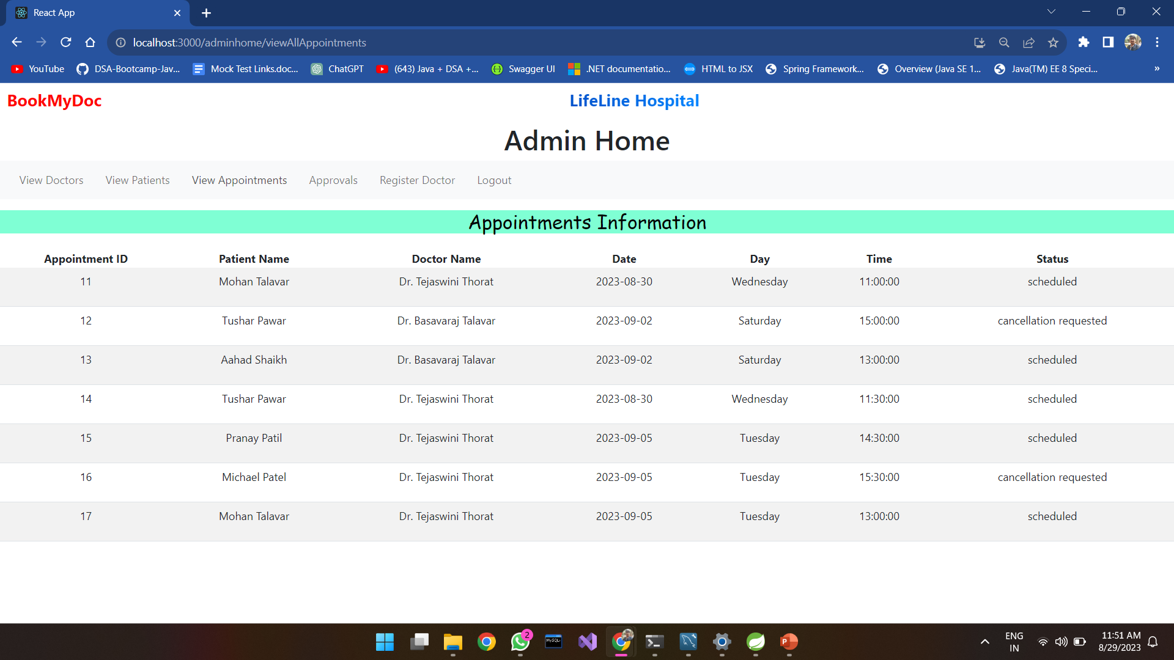

Slide 42
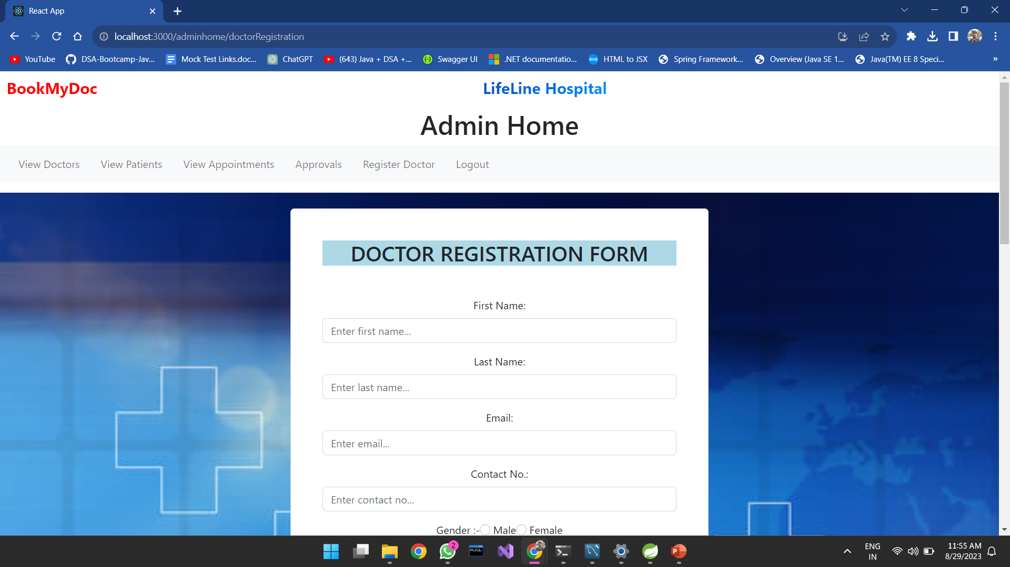

Slide 43
Thank You

